Slide 1
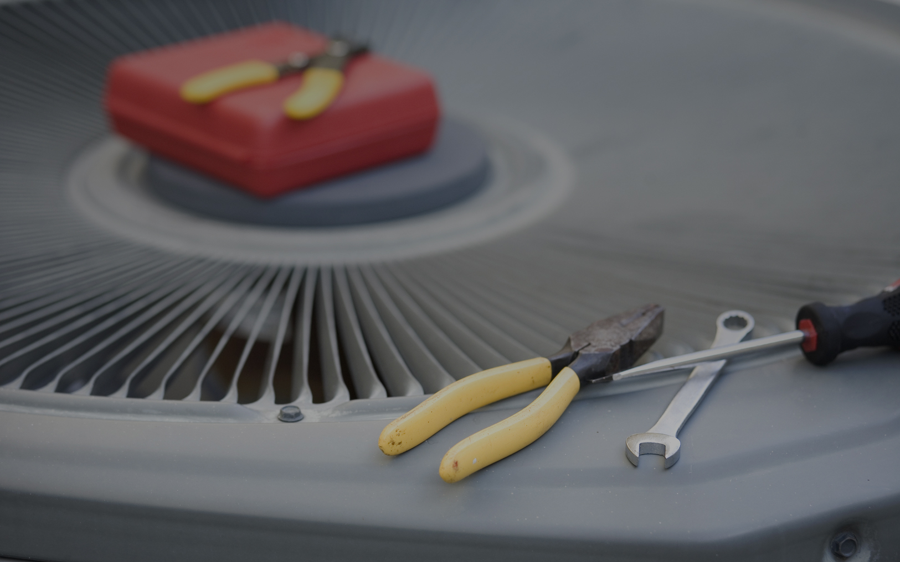


Power Your Career
Electricity Fundamentals

Slide 2


Electricity Fundamentals
Objective
Become familiar with ….
Need edits/formatting

Slide 3
Electricity Fundamentals
Introduction to Electricity
Atomic theory of matter and electricity
Atom components:
  Nucleus:
    Protons – positively charged
    Neutrons – no charge
  Electrons – negatively charged
Usually atoms have equal number of protons & electrons
Gaining or losing an electron “charges” an atom – negatively or positively
Metals have electrons that can easily be “knocked out of orbit” around the nucleus – these free electrons and the materials are conductors
When atom loses electrons, it contains a + charge; the atom can easily attract and acquire additional electrons, making it negatively charged
Alternating state of positively and negatively charged particles permits flow of electrons between the two atoms
Flow of electrons is electrical energy - electricity
Notes:
All matter in the universe is composed of elements. To date, over 100 elements have been found in our universe. To break down the elements, we must look at the atom, which is the smallest particle of an element that can exist alone or in combination with others.
The center of an atom is the core or nucleus. The nucleus is composed of protons, which are positively charged particles, and neutrons, which are neither positively nor negatively charged. Atoms of the same element always have the same number of protons (called the atomic number), but the number of neutrons can vary with different atoms of the element. Atoms than contain a different number of protons and neutrons are called isotopes of the element.
The other part of the atom is composed of electrons, negatively charged, which orbit the nucleus, very much like our moon orbits the earth.
Usually atoms have an equal number of protons and electrons. When this is true, the atom is considered electrically neutral. Under certain conditions, however, either gaining or losing an electron can unbalance an atom. When this occurs an atom can become either negatively or positively charged.
Metal's atomic structure has electrons that can easily be "knocked out of their orbits" around the nucleus. These free electrons and the materials (metals) are called conductors. When an atom loses its electrons, it becomes unbalanced and contains a positive charge. When this occurs the atom can easily attract and acquire additional electrons; this makes the atom negatively charged.
When this alternating state of positively then negatively charged particles exists, electrons can flow between the two opposing atoms. This flow of electrons is electrical energy or electricity.

Slide 4
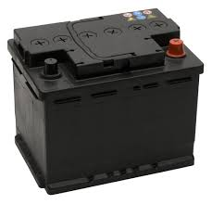
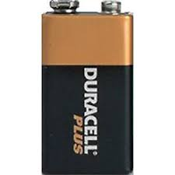
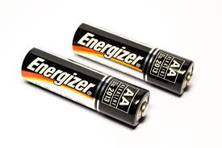
Electricity Fundamentals
Introduction to Electricity
Production of electricity - chemical
Batteries produce flow of electrons by chemical reaction between two electrodes
  Electrodes – “solid conductors through which an electric current can pass”
  One electrode give up electrons; the other collects them
Electrodes constructed of dissimilar metals
When encased in an electrolyte (e.g., acid or paste), electricity is produced by chemical reactions of electrolyte & conductors
Batteries produce Direct Current (DC) – electron flow in one direction only
Notes:
A battery produces a flow of electrons by a chemical reaction between two electrodes within the battery. Electrodes by definition are "solid conductors through which an electric current can pass." One electrode in a battery "gives up" the electrons whereas the other electrode "collects" the electrons. The electrodes are constructed of dissimilar metals. When encased within an electrolyte, such as an acid or paste, electricity is produced by the chemical reactions of the electrolyte and conductors. Batteries produce Direct Current (DC), which is electron flow in one direction only.

Slide 5
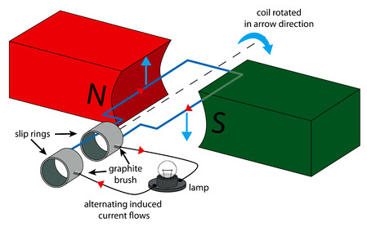
Electricity Fundamentals
Introduction to Electricity
Production of electricity – magnetic induction/magnetism
Most widely used form of electricity generation
Rotating magnets within a coil of wire create lines of force that cause an alternating current (AC) to flow within the wire
Magnets break lines of force and induce AC to be produced
This method of electrical generation powers our homes, offices, and HVAC equipment
Notes:
Magnetic Induction is the most widely used form of electricity generation. This is accomplished by rotating magnets within a coil of wire, whereby the lines of force within the coil cause an alternating current (AC) to flow within the wire. These magnets break the lines of force within the coils of wire and induce alternating current (AC) to be produced. This method of electrical generation is what powers our homes, our offices, and the heating and air conditioning equipment that maintains our comfort.

Slide 6
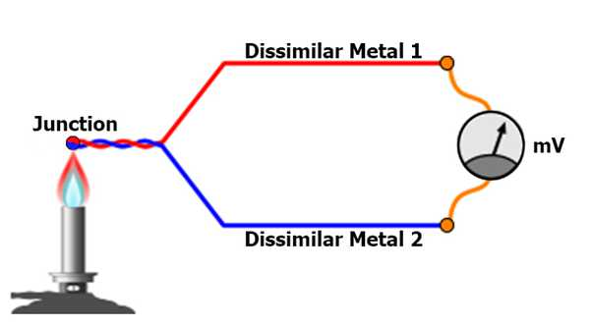
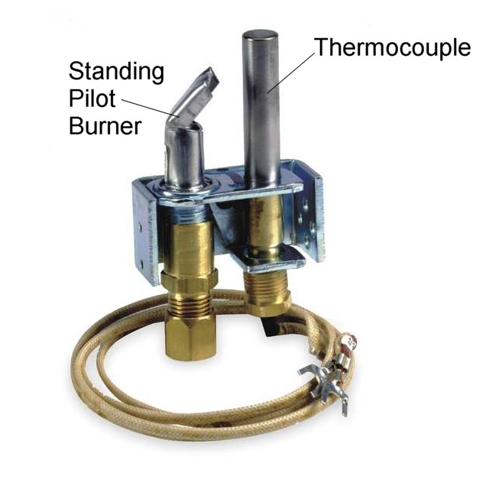
Electricity Fundamentals
Introduction to Electricity
Production of electricity – heat
Small amount of voltage is produced if two dissimilar metals are joined together at one end and the junction is heated
Example: Heat from pilot flame causes thermocouple to create small amount of DC voltage.
  Voltage energizes small coil in gas valve, holding pilot valve open to allow gas to flow
  If flame goes out, heat is removed from thermocouple, causing pilot valve to close
Notes:
If two dissimilar metals are joined together at one end and their junction is heated, a small amount of voltage will be produced.
Example:
The heat from the pilot flame is the source of heat that causes the thermocouple to create a small amount of DC voltage. This DC voltage of approximately 30 mv (millivolts) energizes the small coil in the gas valve (pilot valve), holding the pilot valve open to allow gas to flow. If the flame for any reason is blown out, the heat will be removed from the thermocouple, causing the pilot valve to close.

Slide 7
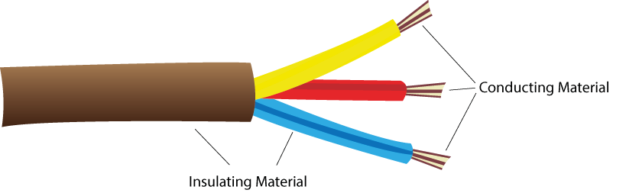
Electricity Fundamentals
Introduction to Electricity
Conductors and insulators of electricity
Conductors
Not all metals conduct electricity equally
Good electrical conductors:
  Copper
  Aluminum
  Silver
Insulators do not easily give up or take on free electrons
Examples:
  Glass
  Rubber
Insulators can fail if:
  Electrical potential exceeds insulating characteristics
  Amount of current exceeds rating of the conductor
Good conductors & insulators are necessary for operation & control of HVAC components
Notes:
The movement of free electrons from one atom to another is facilitated by the characteristics of a good conductor. Most metals are conductors of electricity, but all metals do not conduct electricity equally. Metals that are good electrical conductors are copper, aluminum, and silver. Copper is most widely used because of its lower cost. Silver is a better conducting metal but is most often used only on the surface of contacts in switching devices such as relays or motor starters (contactors) because of its much higher cost.
Insulators are materials that do not easily give up or "take-on" free electrons. Examples of insulators are glass and rubber. How well any insulator works is directly dependent upon the strength of the electrical potential applied—in other words, how high the voltage value is.
No matter how good an insulator is, certain conditions can exist whereby an insulator will fail. If the electrical potential exceeds the insulating characteristics of the insulator or the amount of current exceeds the rating of the conductor, the insulator will fail due to high pressure or high heat, respectively.
The importance of conductors and insulators cannot be understated. Without good conductors or insulators, the circuits necessary to operate and control the components of an HVAC system could not exist.

Slide 8

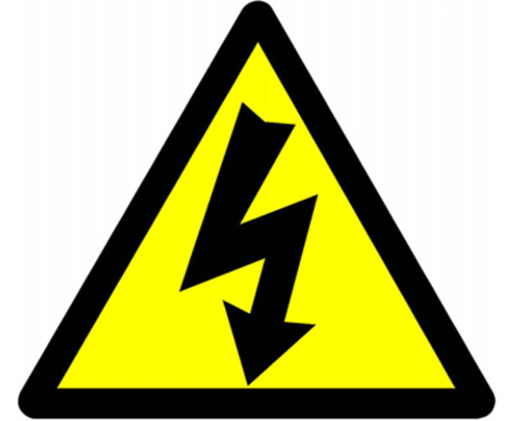
Electricity Fundamentals
Introduction to Electricity
Electrical potential (Voltage)
Voltage (represented by “E”) is the pressure behind electron flow
Volt measures pressure of electricity
  Does not indicate total amount of energy being used
  Just as with a water pipe, there can be pressure without flow when it is turned off
Drop in pressure occurs when demand of usage exceeds capabilities of incoming supply
  Example: When a large load starts, lights dim for a second
  Voltage drops when this occurs
Systems that run on higher voltage have capability of using more total energy, but usage is determined by the load doing the work
Notes:
Voltage (represented with the symbol “E”) is the pressure behind electron flow. Naturally if there is no pressure, there is no reason for electrons to move. The volt measures the pressure of electricity. Keep in mind that pressure alone does not indicate the total amount of energy being used. Just as with a water pipe, you can have pressure without flow when it is turned off.
Everyone has experienced a drop in water pressure when additional faucets are opened. The same concept can be applied with electricity when the demand of usage exceeds the capabilities of the incoming supply. Sometimes when a large load starts, the lights will dim for a second. The pressure (voltage) of electricity is dropping when this occurs. Systems that run on a higher voltage level have the capability of using more total energy because of the higher pressure, but the usage is determined by the load doing the work.

Slide 9
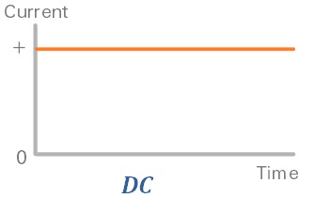
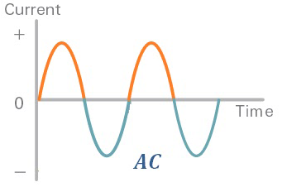
Electricity Fundamentals
Introduction to Electricity
Current flow (Amperage)
Amperage (represented by “I”) is the flow of electrons: current
For current to flow, must be a complete path from the power source to the load and back
  Pathway is called a circuit
Two types of current:
  Direct Current (DC) – flow of electrons in one direction
  Alternating Current (AC) – flows in two directions (change in direction is called frequency, measured in hertz)
Current is measure in amperes (represented by symbol “A”)
  1 microamp (µ) = 0.000001
  1 milliampere (m) = 0.001
  1 kiloamp (k) = 1000
Notes:
Amperage (represented with the symbol “I”) measures the flow of electrons and is referred to as current. In order for the current to flow, there must be a complete path from the power source to the load and back. These pathways for electricity are called circuits.
There are two types of electrical current: Direct Current (DC) and Alternating Current (AC).
Direct current is the flow of electrons in one direction. Outside the source, direct current flows from the negative potential to the positive potential. Direct current is seldom used in powering HVAC equipment; it is, however, used in control or sensing circuits.
Alternating current flows in two directions. It flows back and forth between the source and the load, changing directions 60 times a second in domestic applications. This change in direction is referred to as frequency and is measured in hertz.
The current in both direct and alternating circuits is measured in amperes (represented by the symbol “A”). Amperes are measured with an ammeter. In small amounts, amperes are measured in either microamps (millionths of an amp) or milliamps (thousandths of an amp). In larger amounts amperes are measured in kiloamps (thousands of amps).
1microamp (μ) = 0.000001
1 milliampere (m) = 0.001
1 kiloamp (k) = 1000
The importance of measuring amperes is to help the technician in determining the correct operation of the equipment being serviced. All electrical devices, when energized, draw electric current. These electrical devices require a certain amount of current. When we compare actual current draw to rated current draw, a determination can be made as to the health and load of the electrical component.

Slide 10
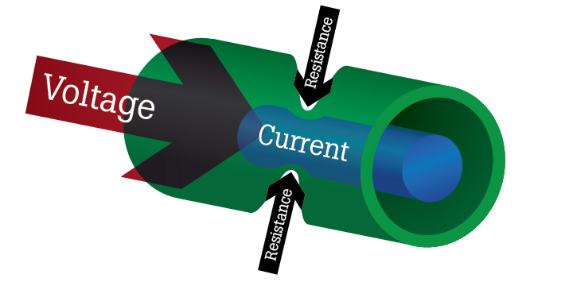
Electricity Fundamentals
Introduction to Electricity
Resistance (opposition to current flow)
Resistance (represented by “R”) is the opposition to current flow – measured by the Ohm (Ω).
There is some resistance in conductors of electricity
  Example: If you run extension cord down street, three will be voltage drop when you energize a large load, due to resistance in the wire
As long as the pathway (wire) is sized correctly, there should only be minimal voltage drop
Notes:
Resistance (symbol “R”) is the opposition to current flow and is measured by the "Ohm." Like a long water pipe, there is some resistance in the conductors of electricity. If you run an extension cord down the street to a neighbor's home, there will be some pressure drop (voltage drop) when you energize a large electric load. This voltage drop is due to the resistance in the wire. As long as the pathway (wire) is sized correctly, there should only be a minimal voltage drop.

Slide 11
Electricity Fundamentals
Introduction to Electricity
Wattage (electric power)
Wattage (represented by “W” or “P”) is the measurement of electric power – the rate at which electrons do work
One watt = power generated by one ampere of current driven by one volt
Total power consumed is measured by the watt
Electricity is sold by kilowatt hour (1000 watts)
Two formulas to remember:
  1 Watt = 3.413 BTUHs of heat
  1 Horsepower = 746 watts
Notes:
Wattage (symbol “W” or “P”) is the measurement of electric power, which is the rate at which electrons do work. One watt is equal to the power generated by one ampere of current driven by one volt. The total power consumed is measured by the watt. Electricity is sold to the consumer by the kilowatt hour (1000 watts).
There are two formulas you need to remember relevant to wattage:
1 Watt = 3.413 BTUHs of heat
1 Horsepower = 746 watts

Slide 12
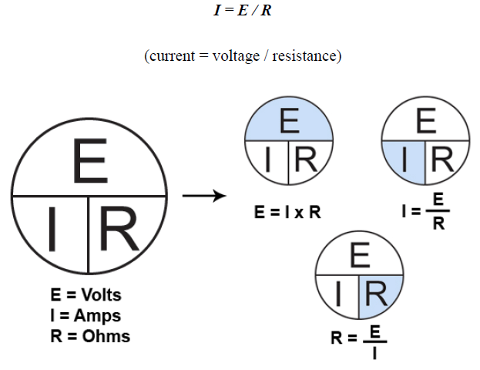
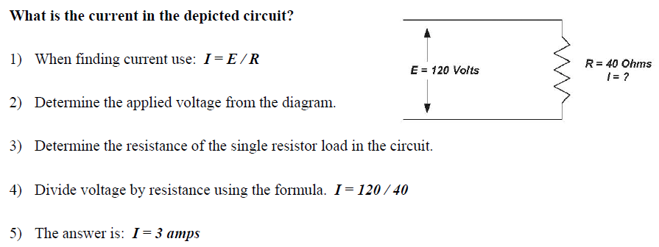
Electricity Fundamentals
Introduction to Electricity
Ohm’s Law
Ohm’s Law = mathematical relationship between voltage, current, and resistance
Key to using Ohm’s Law is knowing any two of the three
Example:
Notes:
Ohm's Law shows the mathematical relationship between voltage, current, and resistance. In order for you, the technician, to use a current measurement to help in determining the "health" of an electrical component (in the previous section), you must have a formula for determining how much current can be measured in a circuit when a voltage is applied to a known resistance. Ohm's Law does this for you.
The key to using Ohm's Law is knowing any two of the three elements. When voltage and resistance are known, current can be found. Likewise, when current and resistance(s) are known, voltage can be determined for a circuit or voltage drop across a component in a circuit.
Ohm’s law is expressed with the following formula:
I = E / R
(current = voltage / resistance)

Slide 13
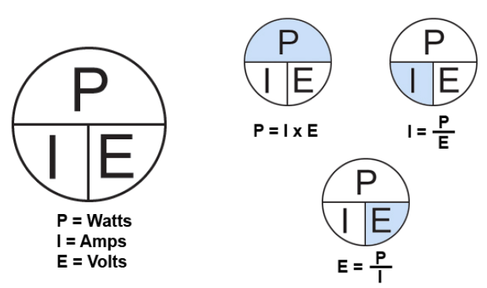
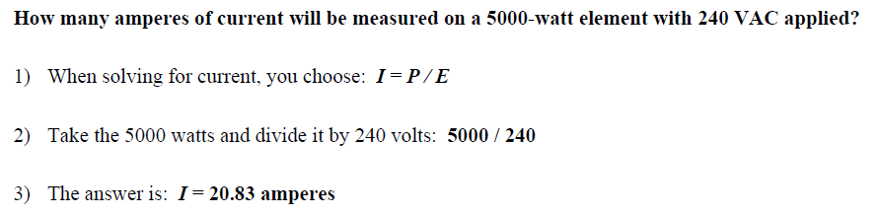
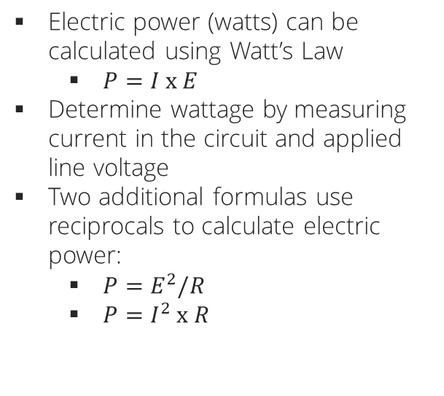
Electricity Fundamentals
Introduction to Electricity
Watt’s Law
Electric power (watts) can be calculated using Watt’s Law
  $P=I x E$
Determine wattage by measuring current in the circuit and applied line voltage
Two additional formulas use reciprocals to calculate electric power:
  $P=E^{2}/R$
  $P=I^{2} x R$
Example:
Notes:
Electric power is the rate at which electron flow does work. Electric power (watts) can be calculated by using the Watt’s Law formula. This formula, P = I x E, allows the technician to determine wattage or electric power by measuring current in the circuit and applied line voltage. Taking the formula, you multiply current times voltage, and electric power or wattage is determined.
In HVAC, resistive heaters and motors consume power. To measure their power, we must use conversions. One horsepower is equal to 746 watts. One watt is equal to 3.413 BTUH (BTUs per Hour).
To convert watts to BTUs, we must use Watt’s Law and the conversion. Here’s an example: Two heating elements each receive 240 VAC. The total current measured on both elements is 41.5 amperes. Using PIE we calculate watts.
P = I x E
P = 41.5 x 240
P = 9960
BTUs = P x 3.413
BTUs = 9960 x 3.413
BTUs = 33993
Two additional formulas in Ohm's Law use reciprocals to calculate electric power. Watts (P) can be found by squaring the measured voltage and dividing it by the measured resistance. The other method allows you to square the measured current and multiply it by the measured resistance. These two formulas are shown below.
P = E2/ R
P = I2x R
The following examples will show you how to use the PIE formula and the two reciprocal power calculating formulas.
Example 1
How many amperes of current will be measured on a 5000-watt element with 240 VAC applied?
1) When solving for current, you choose: I = P / E
2) Take the 5000 watts and divide it by 240 volts: 5000 / 240
3) The answer is: I = 20.83 amperes
Example 2
How many volts are applied to a circuit with a rated 7500-watt element and measured current of
31.5 amperes?
1) When solving for E (Volts) choose: E = P / I
2) Take the rated 7500 watts and divide it by the amperes: 7500 / 31.5
3) The answer is: E = 240 volts
Example 3
1) When solving for P (Watts) and only voltage and resistance are known, choose the formula:
P = E2 / R
2) Take the rated voltage of 240 and square it: 240 x 240 = 57,600
3) Divided the product of 2402 by the resistance of 11.5 ohms: 57,600 / 11.5 = 5008
4) The answer is: P = 5008 watts of power
Example 4
How many watts of power are produced when measured current is 25 amperes and measured
resistance is 9.6 ohms?
1) When solving for P and current and resistance are known, choose the formula: P = I2 x R
2) Square the current: I2 = 25 x 25 = 625
3) Multiple the product of I2 by the resistance = 625 x 9.6 = 6000
4) The answer is: P = 6000 watts of power

Slide 14
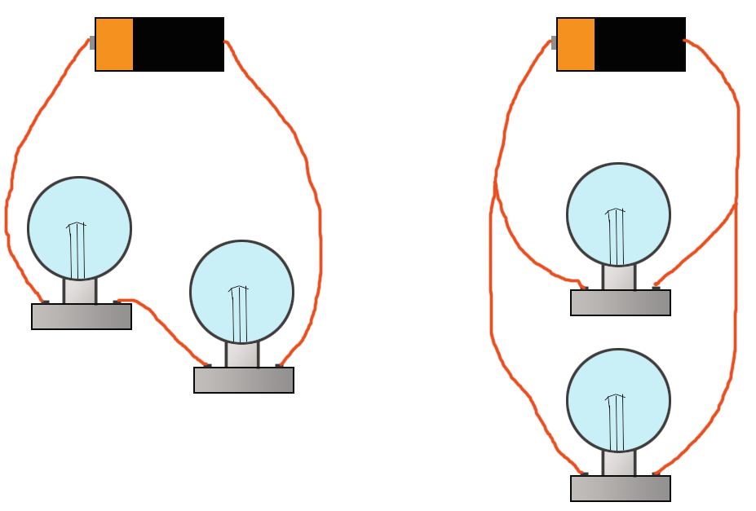
Electricity Fundamentals
Electrical Circuits
Introduction to circuits
Series circuits – only one path for current to flow
Parallel circuits – more than one path for current to flow; each branch receives source voltage
Series-parallel circuits – combine the two types; usually comprised of a switch or switches wired in series with two or more parallel circuits
Series Circuit
Parallel Circuit
Notes:
The knowledge of electrical circuitry in all heating and cooling systems is critically important to the technicians who install and service comfort equipment. Air handlers, condensers, heat pumps, and gas heating units all contain various types of circuits, each designed to do a specific job. The two most important kinds of circuits found in comfort equipment are the series circuit and the parallel circuit.
Series circuits are electrical circuits with only one path for current to flow. They are often used for devices that are either control or safety oriented. An example would be a safety switch that opens when heat exceeds its rating, turning off the component(s) that generate the heat.
Parallel circuits have more than one path for current to flow. Each branch of the parallel circuit receives source voltage. Each branch has a load that performs a specific task. For example, the condenser fan motor and compressor in a condensing unit both receive source voltage, and each has a specific task.
Series-Parallel circuits combine these two types of circuits. These combination circuits are usually comprised of a switch or switches wired in series with two or more parallel circuits. When the switch opens, the components are disconnected. An example would be the contactor wired in series with the condenser fan motor and compressor that are wired parallel.
As a service technician, you must understand the circuits of comfort equipment in order to install and service this equipment. In the next section, we will take a closer look at the make-up of electrical circuits.

Slide 15
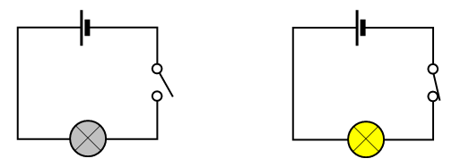
Electricity Fundamentals
Electrical Circuits
Closed vs. open circuits
Circuit – combines source voltage, a load, and connecting wire to make a path of current flow
Closed circuit – circuit is complete and current can flow from source to the load and return to the source; work can be done
Open circuit – current path is broken or interrupted and no current can flow; work cannot be done
Open Circuit
Closed Circuit
Notes:
What is an electric circuit? An electric circuit combines source voltage, a load (such as a motor or element), and connecting wire to make a path of current flow.
Closed Circuit: When the circuit is complete and current can flow from the source through the connecting wiring, to the load, and return to the source, it is said to be a "closed circuit," allowing work to be done.
Open Circuit: When that same current path is broken or interrupted and no current can flow, it is referred to as an "open circuit," and work cannot be done.
When the attached loads of these circuits are fan motors, compressors, and heating elements, the HVAC equipment can cool or heat the air. When we combine automatic switches powered by low voltage, such as thermostats, we can control the sequence of operations to make the comfort equipment "stand alone."

Slide 16
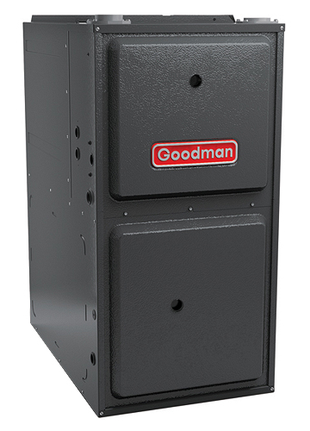
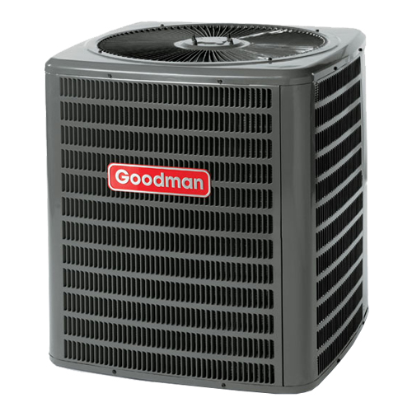
Electricity Fundamentals
Electrical Circuits
Source voltage
Source voltage = supply voltage wired to the cooling or heating appliance
Typically:
  120 VAC for gas heating
  240 VAC for air conditioners, air handlers, & heat pumps
120 VAC
240 VAC
Notes:
Source voltage is the supply voltage that is wired to the cooling or heating appliance. In the residential heating and cooling industry, we usually use 120 VAC (Volts Alternating Current) for gas heating and 240 VAC for air conditioners, air handlers, and heat pumps.

Slide 17
Electricity Fundamentals
Electrical Circuits
Source voltage – 120 Volt circuits
From home electrical panel, where either fuses or circuit breakers are installed:
Three wires to the receptacle:
  Black wire is “hot” and attached to the load side of the fuse or circuit breaker
  White wire is attached to neutral terminal buss in service panel
  Green wire is ground – attach to ground terminal buss in home service panel
At the receptacle, attach the wires accordingly
  Black (hot) attached to the short vertical terminal of the receptacle
  White (neutral) attached to long vertical terminal of the receptacle
  Green (ground) attached to green ground screw (bottom, round hole in 15 amp receptacle)
Notes:
How do we get 120 volts to a gas heating product? From the home electrical panel, where either fuses or circuit breakers are installed, we bring three wires to the receptacle.
The black wire is electrically "hot" and is attached to the load side of the fuse or circuit breaker.
The white wire is attached to neutral terminal buss in the service panel.
The green wire is the ground wire. We attach the green wire to the ground terminal buss in the home service panel.
At the receptacle we attach the wires accordingly.
The black (hot) wire is attached to the short vertical terminal of the receptacle.
The white (neutral) wire is attached to the long vertical terminal of the receptacle.
The green (ground) wire is attached to the green ground screw, which is the bottom, round hole in the 15 amp receptacle.

Slide 18
Electricity Fundamentals
Electrical Circuits
Source voltage – 240 Volt circuits
Three wires run from home electric panel to 240 volt service panel for the air conditioning component:
Red (hot) wire run from L1 side of dual, 240 V circuit breaker
Black (hot) wire run from L2 side of dual, 240 V circuit breaker
Green (ground) wire run from ground terminal buss
At service disconnect panel for the 240 VAC air conditioning components, the opposite ends of the three wires are wired:
Red (hot) wire attached to L1 line side of disconnect switch
Black (hot) wire attached to L2 line side of disconnect switch
Green (ground) wire attached to ground lug in service disconnect panel
Notes:
When wiring 240 volts to an air conditioner or other 240 VAC component of an air conditioning system, three wires are also run from the home electrical panel to the 240 volt service panel for the air conditioning component.
Typically, this is how it is wired:
A red (hot) wire is run from the L1 side of a dual, 240 volt circuit breaker.
A black (hot) wire is run from the L2 side of the dual, 240 volt circuit breaker.
A green (ground) wire is run from the Ground Terminal Buss.
At the service disconnect panel for the 240 VAC air conditioning components, the opposite ends of the three wires are wired.
The red (hot) wire attaches to the L1 line side of the disconnect switch.
The black (hot) wire attaches to the L2 line side of the disconnect switch.
The green (ground) wire is attached to ground lug in the service disconnect panel.
When the installer attaches the electrical wires from the 240 VAC air conditioning component, he or she will attach the red wire to the red wire load terminal, the black wire to black wire load terminal, and the ground wire to the ground terminal Buss in the Disconnect Panel.
Although in 240 volt systems the wiring is usually connected as previously listed, line 1 and line 2 are interchangeable. Many times, 240 volt circuits use the same color wire and no attempt is made to identify line 1 from line 2.

Slide 19
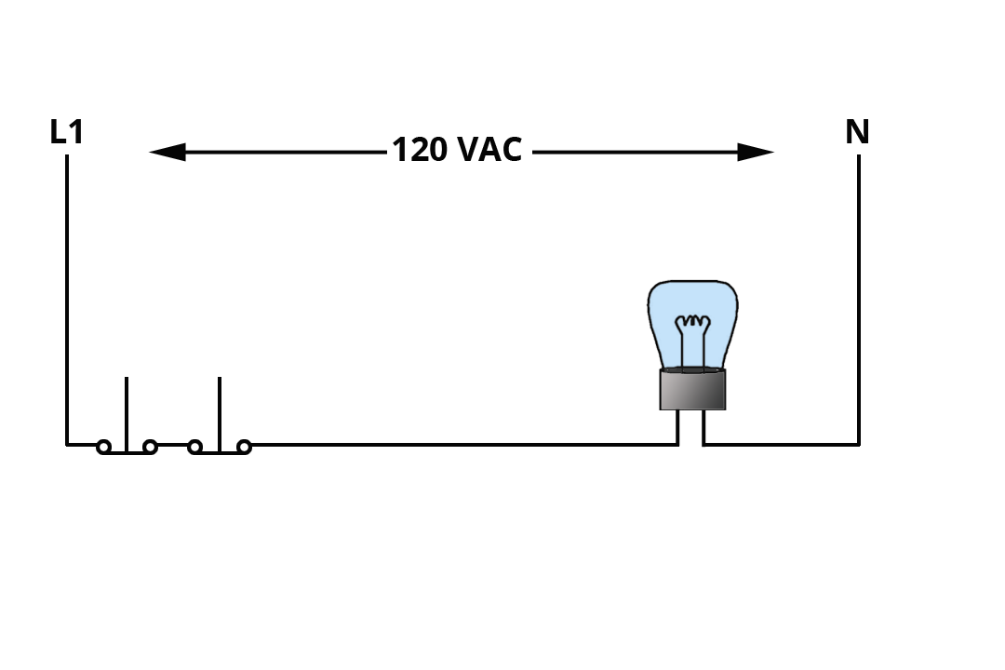
Electricity Fundamentals
Electrical Circuits
Series circuits
One current path
Often used to control one or more loads by wiring switches or controls in series with loads
This diagram shows a typical series circuit with two switches wired in series controlling the load
  If either switch opens, current path will be interrupted; circuit will be de-energized
Series Switches Controlling One Load
Notes:
The easiest circuit to understand is the series circuit. Within a series circuit, there is only one current path, meaning that the current within that circuit must pass through each component of that circuit for it to function. The series circuit is often used to control one or more loads by wiring switches or controls in series with the loads.
The diagram onscreen shows a typical series circuit with two switches wired in series, controlling the load. If either switch opens, the current path to the load will be interrupted and the circuit will be de-energized. In circuits with series controls, all of the switches must be closed for the load to operate.

Slide 20
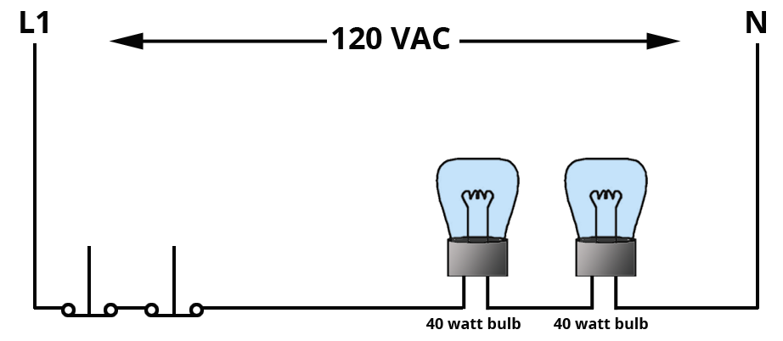
Electricity Fundamentals
Electrical Circuits
Series circuits, cont.
Two or more loads can be wired in series
Both loads share total supply voltage, based on resistance of each load
If resistance in each load is the same, voltage is divided equally
If resistance of one load is higher than resistance of the second load, the load with higher resistance will receive higher voltage across that load
Series Loads of Equal Wattage and Resistance
Notes:
In addition to having one or more switches wired in series with a load, two or more loads can be wired in series as well. When this occurs, both loads will be sharing total supply voltage, based upon the resistance of each of the loads. If the resistance in each load is the same, then the voltage will be divided equally. If the resistance of one load is considerably higher than the resistance of the second load, the load with the higher resistance will receive the higher voltage across that load. Example: If one of the loads has half of the total circuit resistance, it will receive half of the total circuit voltage.

Slide 21
Electricity Fundamentals
Electrical Circuits
Rules for series circuits
When 2 or more resistive loads are wired in series, “rules to remember” are:
Current remains the same throughout the series circuit
Voltage will be divided in proportion to the resistance of each load
If any of the series loads fails (opens), all loads will stop working
Total resistance of the series circuit is the sum of all resistances in the series circuit
Sum of the voltage drops across each resistive load is equal to applied or source voltage
Notes:
When two or more resistive loads are wired in series, there are "Rules to Remember." The Rules for Series Circuits are:
The current remains the same throughout the series circuit.
The voltage will be divided in proportion to the resistance of each load.
If any of the series loads fail (opens), all loads will stop working.
Total resistance of the series circuit will be the sum of all resistances in the series circuit.
The sum of the voltage drops across each resistive load is equal to applied or source voltage.

Slide 22
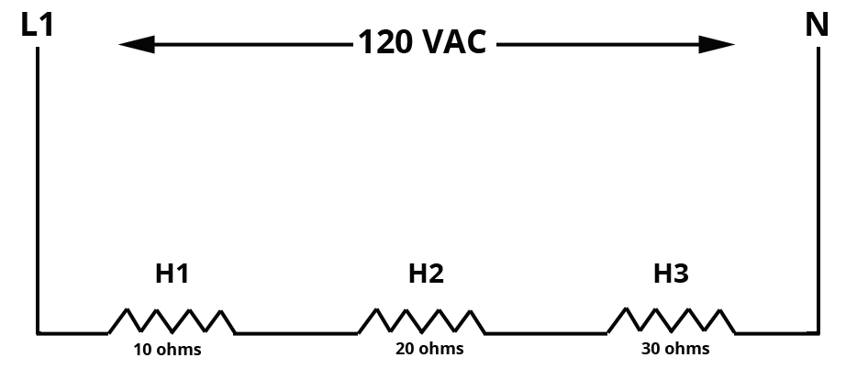
Electricity Fundamentals
Electrical Circuits
Calculating current, resistance, & voltage in a series circuit
In this diagram: 3 resistive heaters wired in series
Each has a different resistance value
When voltage is applied, voltage will be divided in proportion to resistance
Amount of voltage across each will be different
Voltage referred to as voltage drop
Each heater consuming part of the voltage causes a voltage drop to the other heaters
Series Loads of Unequal Values
Notes:
In the diagram below we have three resistive heaters wired in series. Each of the heaters has different resistance values. When voltage is applied, remembering Rule 2 above, the voltage will be divided in proportion to the resistance. The amount of voltage across each heater will be different. This voltage is referred to as a voltage drop. A voltage drop is the voltage used in the process of moving the current through that part of the series circuit.
Each heater consuming part of the voltage causes a voltage drop to the other heaters.

Slide 23
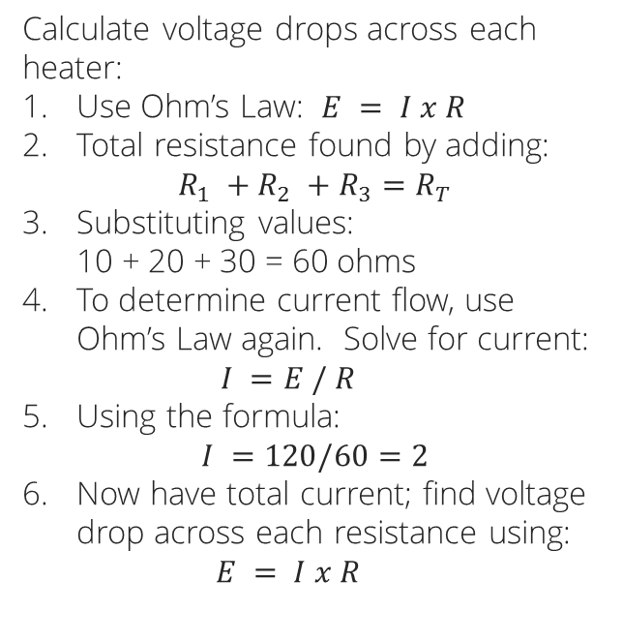
Electricity Fundamentals
Electrical Circuits
Calculating current, resistance, & voltage in a series circuit, cont.
Calculate voltage drops across each heater:
Use Ohm’s Law: $E = I x R$
Total resistance found by adding:
$R_{1} +R_{2} +R_{3}=R_{T}$
Substituting values:
10 + 20 + 30 = 60 ohms
To determine current flow, use Ohm’s Law again. Solve for current:
$I =E / R$
Using the formula:
$I =120/60=2$
Now have total current; find voltage drop across each resistance using:
$E = I x R$
Series Loads of Unequal Values

Slide 24
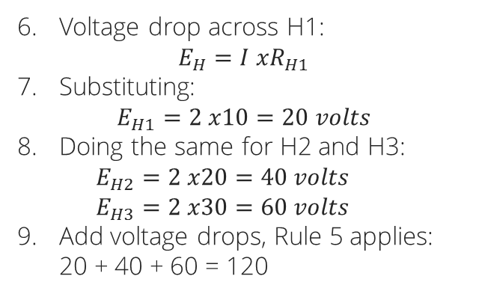
Electricity Fundamentals
Electrical Circuits
Calculating current, resistance, & voltage in a series circuit, cont.
Voltage drop across H1:
$E_{H}=I xR_{H1}$
Substituting:
$E_{H1}=2 x10=20 volts$
Doing the same for H2 and H3:
$E_{H2}=2 x20=40 volts$
$E_{H3}=2 x30=60 volts$
Add voltage drops, Rule 5 applies:
20 + 40 + 60 = 120
Series Loads of Unequal Values

Slide 25
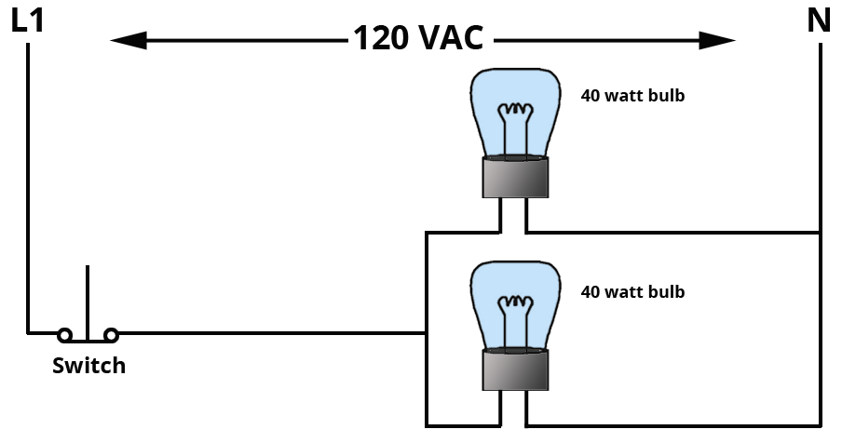
Electricity Fundamentals
Electrical Circuits
Parallel circuits
More than one current path
Most electrical components in heating or cooling products are arranged in parallel so each component receives source voltage
In this example, both loads receive the source voltage of 120 VAC
Total amperage is the sum of amps in each load circuit
Parallel Circuit – Two Loads
Notes:
As we discussed earlier, the majority of electrical components in a heating or cooling product are arranged in parallel so that each component will receive source voltage. In the following example, both loads receive the source voltage of 120 VAC and are thus wired in parallel. The total amperage is the sum of amps in each load circuit.
Remember: In order for the loads in heating and cooling products to receive source voltage of either120 or 240 VAC, they must be wired in parallel!

Slide 26
Electricity Fundamentals
Electrical Circuits
Rules for parallel circuits
When 2 or more resistive or inductive loads are wired in parallel, “rules to remember” are:
All loads receive full line voltage (source voltage)
The total amperes in the circuit are the sum of the individual amperes measured in each branch of the parallel circuits
Each load operates independently of the others; if one load fails, the others will continue to work
Total resistance of all branches in parallel is less than the smallest branch’s resistance (total resistance is less than the least)
Notes:
When two or more resistive or inductive loads are wired in parallel, these are the "Rules to Remember.“
All loads receive full line voltage (source voltage).
The total amperes in the circuit are the sum of the individual amperes measured in each branch of the parallel circuits.
Each load operates independently of the others. If one load fails, the others will continue to work.
Total resistance of all branches in parallel is less than the smallest branch’s resistance. (Total resistance is less than the least!)

Slide 27
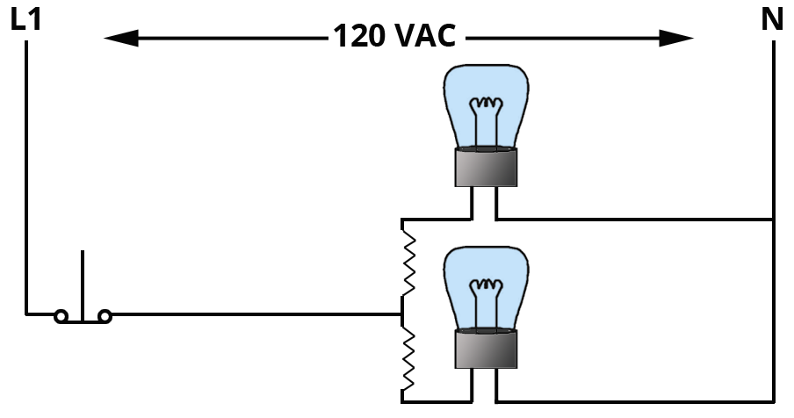
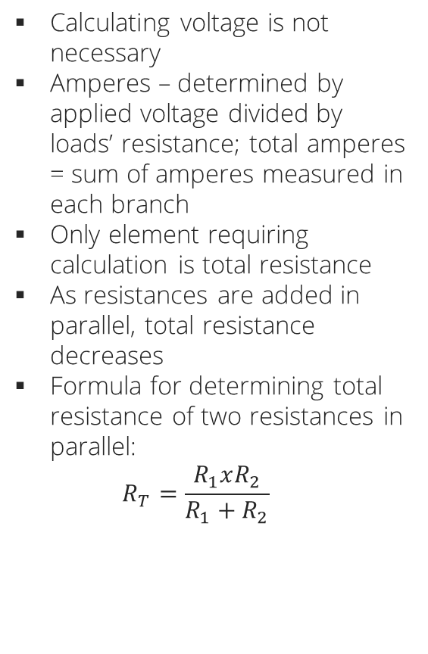
Electricity Fundamentals
Electrical Circuits
Calculating resistance in a parallel circuit
Calculating voltage is not necessary
Amperes – determined by applied voltage divided by loads’ resistance; total amperes = sum of amperes measured in each branch
Only element requiring calculation is total resistance
As resistances are added in parallel, total resistance decreases
Formula for determining total resistance of two resistances in parallel:
$R_{T}=\frac{R_{1}xR_{2}}{R_{1}+R_{2}}$
Notes:
Since all loads receive line voltage, calculating voltage is not necessary in parallel circuits. Amperes are determined by the applied voltage divided by the loads’ resistance. Total amperes are the sum of the amperes measured in each branch. The only element that requires calculation is total resistance.
As resistances are added in parallel, the total resistance for the parallel circuits decreases. The following is a formula for determining total resistance of two resistances in parallel.
REFER TO FORMULA
Remember: Total resistance in a parallel circuit cannot be determined by adding their values. Total resistance must be calculated!

Slide 28
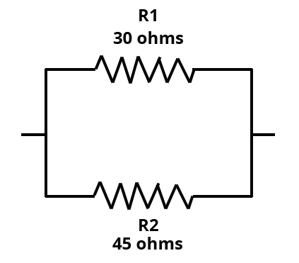
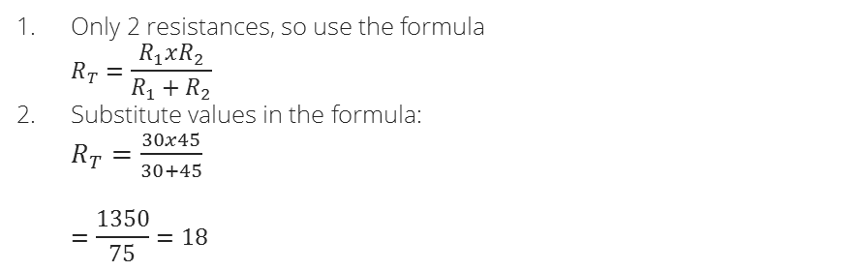
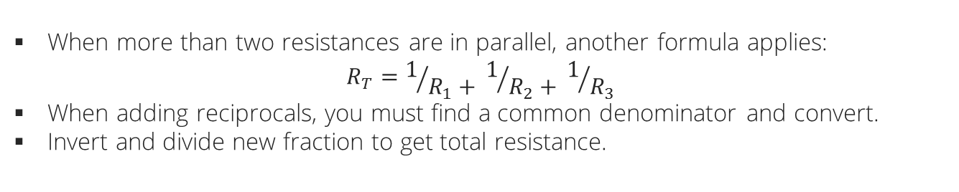
Electricity Fundamentals
Electrical Circuits
Calculating resistance in a parallel circuit, cont.
When more than two resistances are in parallel, another formula applies:
$R_{T}=1/{R_{1}+ }1/{R_{2}+ }1/{R_{3}}$
When adding reciprocals, you must find a common denominator and convert.
Invert and divide new fraction to get total resistance.
Example 1:
Find total resistance in this diagram
Only 2 resistances, so use the formula
$R_{T}=\frac{R_{1}xR_{2}}{R_{1}+R_{2}}$
Substitute values in the formula:
$R_{T}=\frac{30x45}{30+45}$
$=\frac{1350}{75}=18$
Notes:
When more than two resistances are in parallel, another formula applies. The reciprocal formula states: "Total resistance is equal to the sum of the reciprocals2 of all resistances.”
REFER TO FORMULA
When adding reciprocals, you must find a common denominator3 for all numbers. Once this is found, the fraction must be converted to the common denominator. Once the fractions with common denominators are added, you must invert and divide the new fraction to get total resistance.

Slide 29
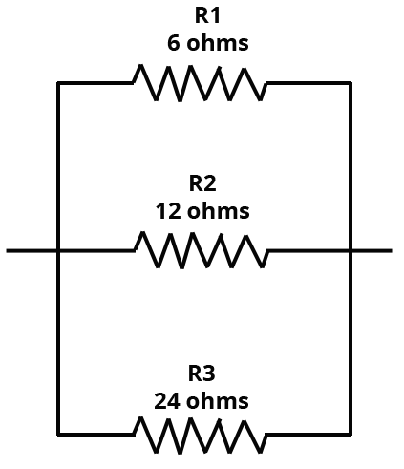
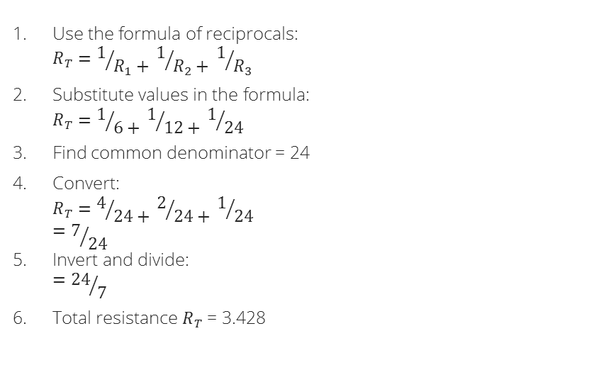
Electricity Fundamentals
Electrical Circuits
Calculating resistance in a parallel circuit, cont.
Example 2:
Find total resistance in this diagram
Use the formula of reciprocals:
$R_{T}=1/{R_{1}+ }1/{R_{2}+ }1/{R_{3}}$
Substitute values in the formula:
$R_{T}=1/{6+ }1/{12+ }1/{24}$
Find common denominator = 24
Convert:
$R_{T}=4/{24+ }2/{24+ }1/{24}$
${=7}/{24}$
Invert and divide:
${=24}/7$
Total resistance $R_{T}$ = 3.428

