Slide 2
Technician Soft Skills
Technician Soft Skills
Objectives
Understand how you should professionally approach a customer
Understand how you can effectively offer enhancement opportunities to the customer

Slide 3
How to Successfully Approach a Customer
Technician Soft Skills
Introduction
Make the customer feel comfortable
Help ease tensions
Relieve any fears
Build good customer relationships
Notes:
In order to succeed in today's business environment, the HVAC professional must be technically competent and must possess the interpersonal skills required to keep even the most disgruntled customer a loyal customer. How a customer is treated will determine if that customer continues to call your company for service or recommend your company to neighbors and friends. As a professional, you want to make the customer feel comfortable, help ease tensions, relieve any fears, and, ultimately, build good customer relationships.

Slide 4
How to Successfully Approach a Customer
Technician Soft Skills
Before Arriving at the Home
Stop in a parking lot to prepare
Check your physical appearance
  Is your uniform clean?
  How’s your hair?
  Is your shirt tucked in?
  Are your shoes clean?
  A mint or shot of mouthwash wouldn’t hurt…
  A shot of deodorant may be in order…
  Take that last puff…
Notes:
Providing your customer with the right kind of experience starts before you arrive at the home. To prepare for your arrival at a customer's home, it's a good idea to stop at a parking lot en route to the home. This keeps you from sitting in the driveway for a few minutes while preparing. Customers can get anxious when you sit in the driveway before or after a service call. The first step in your preparation is to check your physical appearance. The customer’s first impression is based partially on your appearance. A quick check of the following items will help you make a good impression with the customer:
Make sure your uniform is clean. If your last call required you to get dirtier than normal, now is a good time to put on a fresh uniform.
Look in the mirror to make sure you're not having a bad hair day.
Make sure your shirt is tucked in all the way around.
Make sure your shoes are clean on the top as well as on the bottom.
Make sure your personal hygiene is in order, especially after meals. It may be a good time for a mint or some mouthwash.
After that hot attic job you just completed, a shot of deodorant may be in order.
If your company allows smoking in the service trucks, several miles away from the customer's home is the best time for that last puff.

Slide 5
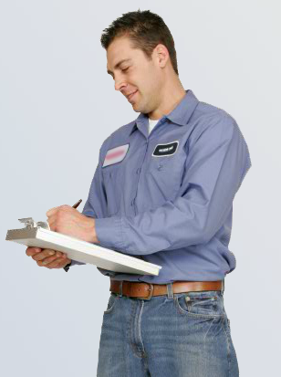
How to Successfully Approach a Customer
Technician Soft Skills
Get Your Paperwork Ready
Customer name and address on invoice
Business Card
Notes:
The next thing you should do is get your paperwork ready. You want to have your paperwork ready so that when you arrive at the home, you can go promptly to the door. Fill out the customer’s name and address on the invoice and have a business card ready. Going to the door with just an invoice on the clipboard and a business card helps make a good first impression because it shows you are prepared and orderly.

Slide 6

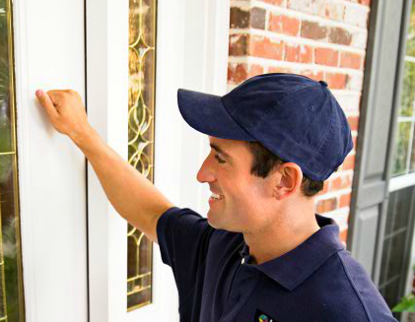
How to Successfully Approach a Customer
Technician Soft Skills
Arriving at the Home
Determine the best place to park
  Maximum advertising effect
  Normal parking spot
  Doesn’t block the customer’s vehicles
If your truck leaks oil, put cardboard under the engine
Go promptly to the door and knock
  Only your clipboard and business card
  Knock – don’t ring the doorbell
  Step back from the door
Notes:
When you proceed to the home, you want to determine the best place to park. In making this decision, look for a place that will position your service truck for maximum advertising effect. This is usually at the curb directly in front of the customer's house or at the beginning of the driveway if it's a long one. Look for a place that appears to be a normal parking spot. Look for a place that does not block the customer’s vehicles. Here’s an effectiveness tip: if your truck leaks oil, place a piece of cardboard under the engine.
After parking, avoid walking on the customer’s lawn and go promptly to the door and knock. You should only have your clipboard and a business card in hand. Knock on the door; do not ring the doorbell, because doorbells may wake small children or disturb pets. After knocking on the door, step back. Backing up a few steps will give the customer their space when they open the door. You should not make any moves forward until the customer has given you the indication to come in.

Slide 7


How to Successfully Approach a Customer
Technician Soft Skills
Communicate with the Customer
Be courteous
Show respect for the customer and their property
Have a pleasant greeting
“Hi, I’m Steve, from ABC Heating & Cooling”
Notes:
Let's look at some objectives for your first contact with the customer. Remember, you only get one chance to make a good first impression. It's essential to be courteous and always have respect for the customer and their property. It's impossible to create a dialogue that will fit every situation, so addressing the concepts is the best way to plan for what happens when the customer opens the door.
The following will help you develop your own approach as you communicate with the customer. First, you want to have a pleasant greeting. In greeting the customer, smile and identify yourself and your company.

Slide 8
How to Successfully Approach a Customer
Technician Soft Skills
Communicate with the Customer
Verify the appointment
State why you are there
Make sure you are talking to the customer
“I believe you requested a performance tune-up today. Are you Mrs. Jones?”
Notes:
Second, verify the appointment. There are several ways to do this, but you need to cover three points: one, verify the appointment; two, state why you were there; three, make sure you are talking to the customer.

Slide 9

How to Successfully Approach a Customer
Technician Soft Skills
Communicate with the Customer
If the person who answered the door is not the customer, start over when the customer comes to the door
Don’t walk past the customer
Ask permission & have the customer show you where to go
Notes:
If the person who answers the door is not the customer, you should start over when the customer does come to the door. Remember, do not walk past the customer. Ask permission and have the customer show you where to go.

Slide 10

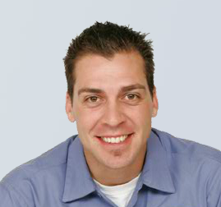
How to Successfully Approach a Customer
Technician Soft Skills
Start Building Rapport
Compliments can help build rapport
Don’t over-do it
An insincere or exaggerated compliment can backfire
Avoid personal compliments
“I’ll put on my floor savers just in case my shoes have any dirt on them. I don’t want to track anything into your home.”
“You’ve got a really nice lawn. It looks like you’ve worked hard on it.”
Notes:
Now you will begin the rapport building process. After the customer invites you in, one of the best ways to start building rapport is to let the customer know you need to put on your floor savers. A genuine compliment can also add to the rapport building process. If you notice something outstanding, it's okay to mention it. BUT…be careful not to overdo it or lay it on too thick. An insincere or over exaggerated complement can backfire. Also, you should always avoid making personal compliments, including compliments about the customer’s family, and do not compliment items that can be taken out of the home. This could make some customers nervous.

Slide 11


How to Successfully Approach a Customer
Technician Soft Skills
Gain Approval to Perform the Job
Let the customer know where you need to be in their home
Ask what access routes they would like you to use
Ask the customer where they will be when you need to advise them of progress
“I’d like to start by seeing the thermostat. Then in a couple minutes, I’ll need to see the indoor and outdoor units.”
Notes:
The next thing you need to do is gain approval to perform the job. This objective is usually done in stages over the next few minutes while you are standing in the home. Let's look at a good starting point that leads you to the thermostat. (Refer to the example on the slide.) A statement like this gives the customer the parameters of what is needed to perform the service. Three key components of this objective are to let the customer know where you need to be in their home, to ask what access routes they would like you to use, and to ask the customer where they will be when you need to advise them of your progress.

Slide 12

How to Successfully Approach a Customer
Technician Soft Skills
Summary
Be polite
Attempt to understand problems from the customer’s point of view
Be conscious of body language
Notes:
As you continue to communicate with the customer during the service call, remember the importance of building rapport. Always show respect for your customer. Be polite and attempt to understand problems from the customer's point of view. Be conscious of the messages your body language sends.

Slide 13
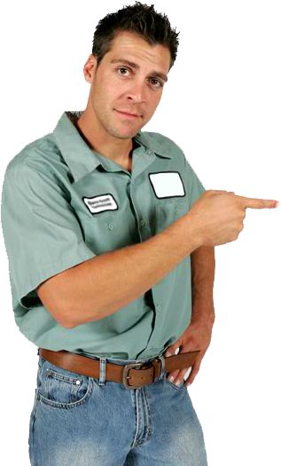
How to Successfully Approach a Customer
Technician Soft Skills
Summary
Appropriate dress & professional appearance
Knowledgeable, polite, & patient
Respectful of customer’s home & property
Performs work neatly & leaves all areas clean
Educates customer on enhancement opportunities – without a high-pressure
sales pitch
Notes:
Now let's sum up what customers expect from a technician:
Appropriate dress and a professional appearance
A knowledgeable, polite, and patient technician
Respectful of the customer’s home and property
Performs the work as neatly as possible and leaves all areas clean
Finally, willing to educate the customer on enhancement opportunities without a high-pressure sales pitch. We’ll explore this last point in depth in the next section of this course.

Slide 14
Technician Selling Skills
Technician Soft Skills
Introduction
Knowing when and how to apply basic sales skills can help you be at the top of your game
Technicians play a critical role in how a company builds relationship with customers
Enhancement opportunities benefit the customer
Notes:
As a technician, you may not see yourself as a salesperson, but knowing when and how to apply some basic sales skills can help you be at the top of your game. When on a service call, technicians play a critical role in how a company builds its relationships with customers. Offering enhancements is another way that you, as a technician, can help the company establish stronger relationships.
First of all it's important to understand that effectively approaching your customer about enhancement opportunities is not just good for you and your company - it's good for the customer. You are offering something that will benefit the customer - whether it's greater peace of mind about the operation of their HVAC system or better air quality. At the same time, you can help your company establish a stronger relationship with the customer because you are taking steps to do more than service a system that needs tune-up or repair.

Slide 15
Technician Selling Skills
Technician Soft Skills
The Right Kind of Sales Approach
See yourself as a consultant
A consultant:
  Believes they need to know what they are selling before they sell it
  Believes that sales is something you do *for* someone, not *to* them
  Doesn’t attempt to make buying decisions for the customer
  Goes to a service call with the attitude of: “What can I do for you?”
  Always plants seeds for tomorrow
Notes:
But there's a right way to approach a customer with an enhancement opportunity. A customer will only respond positively if he or she is comfortable with your approach, so it is critical for you to help the customer feel at ease and to do what you can to help them know they can trust you. One way to do this is to see yourself as a consultant rather than a salesperson. Here are some characteristics of a consultative approach:
A consultant believes they need to know what they are selling before they sell, it so it's essential that you know your product.
A consultant believes that sales is something you do *for* someone, not *to* them.
A consultant doesn't attempt to make buying decisions for the customer.
A consultant goes to a service call with the attitude of “What can I do for you?”
Finally, a consultant always plant seeds for tomorrow.

Slide 16
Technician Selling Skills
Technician Soft Skills
Maintenance Agreements
HVAC Business Model
Leverage your name & the equipment brand to generate sales leads
Differentiate your company with IAQ expertise
86% of MA customers buy new systems from their maintenance provider
Use Maintenance Agreements to build a customer base
Notes:
Look at this HVAC business model and consider the role that building lifelong relationships plays in the success of your company. As you can see, one of the most important ways that you can build lasting relationships with customers is through selling maintenance agreements. Through inspections, demand service, and tune-ups, you have an opportunity to start a relationship. The relationship comes from the customer owning a maintenance agreement. Once this relationship has been established, you can deliver scheduled tune-ups and demand service for any repairs needed between tune-ups, sell IAQ equipment that's right for the customer's home and health, and replace the customer's system when that time arrives.

Slide 17

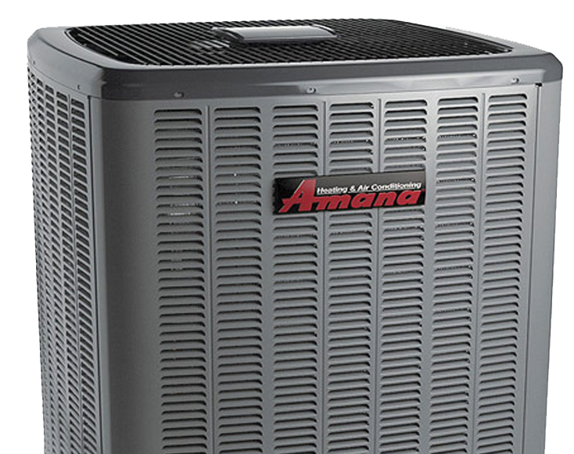
Technician Selling Skills
Technician Soft Skills
Maintenance Agreements
For the customer, a maintenance agreement means:
Peace of mind – equipment will be serviced and maintained by a qualified, trained professional
Equipment will be working at peak efficiency
Repair costs are reduced (or included) in the Agreement price
They get priority service (benefits depend on the MA you offer)
They have a service company they can call, rely on, and trust
Bottom line: leaving the customer WORRY-FREE
Notes:
For the customer, entering into a long-term relationship with your company through a maintenance agreement means:
they have the peace of mind that their equipment will be serviced and maintained by a qualified trained professional;
their equipment will be operating at peak efficiency;
repair costs are reduced or included in the agreement price;
they get priority service;
they have a service company they can call rely on and trust, one that will be there for them when they need repairs or a new system.
It all comes down to leaving the customer worry free.

Slide 18
Technician Selling Skills
Technician Soft Skills
When and How Should You Sell a Maintenance Agreement?
Mention it when you present your findings & recommendations to the customer
Offer the best available plan first – you can always “step down”
Notes:
So when and how should you approach a customer about a maintenance agreement? The best time to first mention the availability of a maintenance agreement is after you have conducted your diagnostic or evaluation of the customer’s system, when you are presenting your findings and recommendations to the customer. You should always offer the best available plan first. You can always “step down” later if the customer is interested but the pricing of the best plan isn't quite right for them.

Slide 19
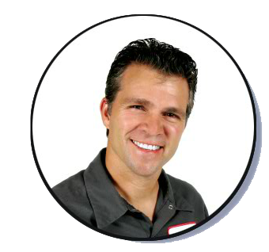
Technician Selling Skills
Technician Soft Skills
Note: This may be modified to reflect offered MAs
When and How Should You Sell a Maintenance Agreement?
“Ms. Moore, would you be interested in learning how you could save 15% on the cost of these repairs? These are the Priority prices for our maintenance agreement customers.”
Notes:
Let's look at an example of how a maintenance agreement can be introduced when presenting findings and recommendations.
(Look at example on the slide.)
The technician then shows Ms. Moore a side-by-side comparison of his company’s priority and standard pricing.

Slide 20
Technician Selling Skills
Technician Soft Skills
Note: This may be modified to reflect offered MAs
When and How Should You Sell a Maintenance Agreement?
“Included in the investment of your Priority Maintenance Agreement, we will do a tune-up of your system today. In addition, you will receive two more tune-up calls over the next year. This would normally cost $178 for the two visits.
“Also with the Maintenance Agreement, you will never pay an overtime fee and you will continue to receive 15% off on future parts if needed. All for only $37 more than your urgent repairs today. If you’d like, we can start saving money right now by performing the first of three maintenance calls, while I also do the repairs that are needed on your system.”
Notes:
After introducing the maintenance agreement, you need to explain some of the savings and advantages of having an agreement.
(Refer to/discuss example on the slide.)

Slide 21
Technician Selling Skills
Technician Soft Skills
Additional Suggestions for MA Introduction
What are some other ways to word your introduction to the Maintenance Agreement?
Notes:
Now think about some other ways you can introduce the maintenance agreement. (Discussion point.)

Slide 22

Technician Selling Skills
Technician Soft Skills
Note: This may be deleted or modified depending on what kind of MAs are offered
Interested in the MA but Concerned about the Cost?
What if the customer shows interest but expresses concern about the cost of the MA even after you have explained the long-term savings?
  If you offer several levels of agreements, offer the next best plan.
“If you’re not sure about the Priority Agreement, we also have a Preferred Maintenance Agreement that would save you 10% on today’s repairs. “
Remember: Always let the customer decide!
Notes:
What if the customer shows interest but expresses concern about the cost of the agreement even after you have explained the long-term savings? If your company offers several levels of agreements, then offer the next best plan.
(Look at example on the slide.)
Of course, if the customer clearly does not seem interested, do not push the idea. Remember - always let the customer decide.

Slide 23

Technician Selling Skills
Technician Soft Skills
Maintenance Agreements
Reminder:
Know your product!
Notes:
When the customer shows interest, it is essential that you clearly explain the coverage and benefits of the agreement. This is why, as we mentioned earlier, it is critical for you to know your product. You want the customer to feel confident that they understand the service plan you are selling them.

Slide 24
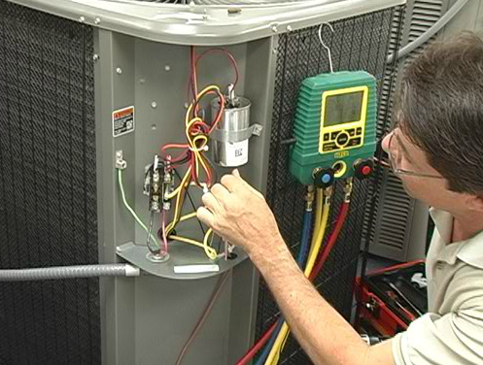
Technician Selling Skills
Technician Soft Skills
Maintenance Agreements
If the MA covers tune-ups, perform the first one now (or schedule it).
Notes:
If the customer does decide to purchase a maintenance agreement and the agreement covers tune-ups, it's a good idea to go ahead and perform a tune-up during this call or at least talk to the customer about scheduling one.

Slide 25

Technician Selling Skills
Technician Soft Skills
IAQ Accessories
Today’s consumers are more:
  Health conscious
  Knowledgeable and demanding
  Concerned about the air quality in their homes
You have a unique opportunity to identify IAQ issues
Notes:
Consumers today are more health conscious, more knowledgeable and demanding, and more concerned about the air quality in their homes. Consequently, indoor air quality has been a growing market in recent years and presents you and your company with another important opportunity to better serve the needs of your customers when it comes to home comfort. When you are on a service call, you have a unique opportunity to not only evaluate a customer’s HVAC system but to identify air quality issues in the home that could be addressed with enhancements to the system.

Slide 26

Technician Selling Skills
Technician Soft Skills
IAQ Accessories
What you can do *for* the customer
Presenting yourself and your company as someone the customer can trust
Notes:
It goes back to the idea of thinking about what you can do for your customer and presenting yourself and your company as someone the customer can trust. While your most important job is to make sure the homeowner’s system is functioning the way it should be, if you take a step beyond that and think about how that system could be enhanced to provide a better living environment, you are going the extra mile to serve the customer, and that in turn helps strengthen the relationship between the customer and your company.

Slide 27
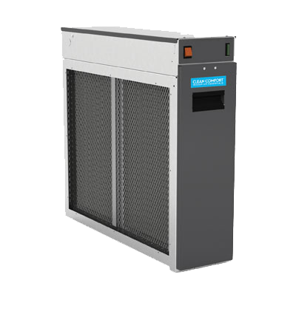
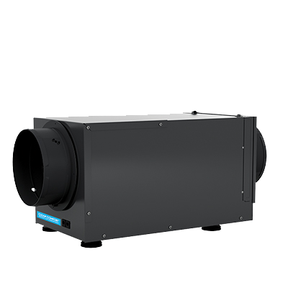
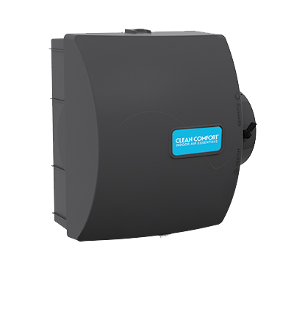
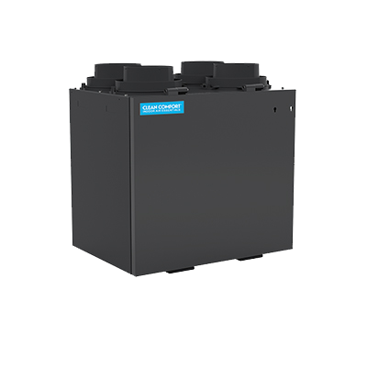
Technician Selling Skills
Technician Soft Skills
IAQ Accessories – Educate Yourself
First:
  Understand IAQ issues
  Be familiar with the products
Educate Yourself
Notes:
Let's look at some principles for identifying and offering IAQ solutions to your customer while on a service call. First of all, it's critical that you understand indoor air quality issues and be familiar with the products that address those issues, so before anything else you need to educate yourself.

Slide 28
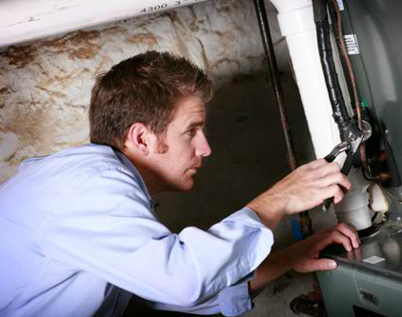
Technician Selling Skills
Technician Soft Skills
Turning a Service Visit into an Opportunity to Offer IAQ Solutions
Be on the lookout for signs of possible IAQ problems in the home
Examples:
  Pet odors
  Noticeable dry air
  Noticeable humidity
  Lingering cooking odors
Notes:
If you're on a call to perform a maintenance tune-up or to identify and repair a system problem, how do you turn that service visit into an opportunity to offer IAQ solutions? We just said that it's important to understand air-quality issues, so while you are in the home you can be on the lookout for indications of possible IAQ problems - for instance, pet odors, noticeable dry air or noticeable humidity, lingering cooking odors. Take note of issues like these because they present you with opportunities to bring up the subject of indoor air quality.

Slide 29

Technician Selling Skills
Technician Soft Skills
IAQ Issues – Example
“Mrs. Jones, does anyone in the home get sinus infections or have dry sinuses?”
Notes:
Let's look at an example. While in the customer's home, Steve takes note of wood flooring, indoor plants, and a piano in the front room. The air in the home is noticeably dry. (Look at the example question on the slide.) A question like this allows Steve to introduce the subject of air quality in the home. From this point, he can explain to the customer that almost all chronic sinus problems are related to indoor air quality and also explain that dry air can cause wood to split, affect the health of indoor plants, and impact the tuning of musical instruments like the piano in the front room.
This is a very important first step in the process of offering IAQ solutions: you need to educate the customer.

Slide 30

Technician Selling Skills
Technician Soft Skills
IAQ Issues - Approaching the Customer
Step 1: Educate the Customer
  Types of contaminants found in a home
  Impact of IAQ on health, comfort, cleanliness
  Strategies for improving indoor air
  Role IAQ plays in complete, continuous indoor comfort
Notes:
In the example we just looked at, if Steve's customer shows interest in the subject of air quality, he can take the conversation a step further than discussing dry air; he can go on to educate Mrs. Jones about things like:
the types of contaminants found in a typical home;
the impact of IAQ on health, comfort, and cleanliness;
the strategies for improving indoor air - in other words, monitoring, elimination/source control, ventilation, filtration/purification;
and the role IAQ plays in complete and continuous indoor comfort.
Let's look at a couple more examples of how you can identify IAQ needs in a home and approach the customer.

Slide 31

Technician Selling Skills
Technician Soft Skills
IAQ Issues – Educating the Customer – Example 1
“Mr. Smith, does anyone in the house suffer from pet allergies or have asthma?”
Notes:
When Kurt enters the customer's home, he notices a lingering pet odor and sees the family dog sitting by the couch in the living room. A good approach in this situation would be to tactfully inform the customer that lingering pet odors can cause health problems in addition to discomfort. (Refer to example on the slide.) This will give Kurt a chance to educate the customer about the role of volatile organic compounds as they relate to health and home comfort and the ways that filtration can address these issues.

Slide 32
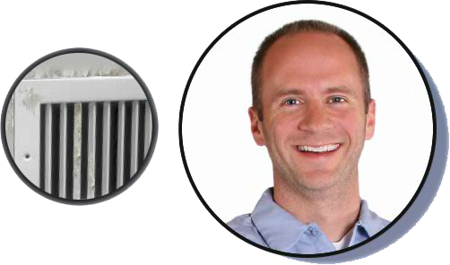
Technician Selling Skills
Technician Soft Skills
IAQ Issues – Educating the Customer – Example 2
“Ms. Garcia, are you aware of the mildew on your registers? These conditions are ideal for contaminant growth.”
Notes:
As Bob walks through the customer's home he sees mildew around the registers, notices the air is clammy, and sees that the thermostat is set below 70°. (Look at example on the slide.) A question like this can give Bob the opportunity to educate the customer on the adverse effects of mold, mildew, and other contaminants that grow in humid conditions.

Slide 33

Technician Selling Skills
Technician Soft Skills
IAQ Issues - Approaching the Customer
Step 2: Conduct Home Assessment
Notes:
Once you have begun talking about indoor air quality, depending on the customer's interest, you may find a window of opportunity for suggesting a more comprehensive IAQ assessment of the home.

Slide 34

Technician Selling Skills
Technician Soft Skills
IAQ Issues - Approaching the Customer
Step 2: Conduct Home Assessment
“If you’d like, I could do a thorough air quality assessment of your home to see if there are any other areas where we might be able to help you.”
Notes:
(Discuss example on the slide.)

Slide 35


Technician Selling Skills
Technician Soft Skills
IAQ Issues - Approaching the Customer
Step 2: Conduct Home Assessment
  Go through a home assessment survey
  Inspect the home from an IAQ perspective
    Look at existing HVAC system:
      Age of equipment
      Efficiency rating of equipment
      Duct leakage
      Any accessories (filtration, upgraded thermostats, etc.)
Notes:
If the customer responds positively to the suggestion, the next step is to sit down with the customer and go through a home assessment survey - a list of questions that will help you identify IAQ issues in the home.
Next, you'll want to inspect the home from an IAQ perspective. This includes looking at the existing HVAC system considering such factors as age of the existing equipment, efficiency rating of existing equipment, duct leakage, and accessories such as filtration, upgraded thermostats, humidifiers etc.

Slide 36
Technician Selling Skills
Technician Soft Skills
IAQ Issues - Approaching the Customer
Step 3: Determine the Right Solutions & Present Recommendations
Best
Better
Good
When presenting recommendations – Don’t forget Maintenance Agreements
Notes:
The next steps are to determine the right solutions to address the issues you have found and then present your recommendations to the customer. Integrate IAQ recommendations with your other recommendations based on your evaluation of the customer’s HVAC system.
When you offer IAQ solutions, keep in mind the Best-Better-Good approach. In other words, when possible, have three levels of alternatives to offer the customer. Start with the best solution and work your way down to a good alternative.
Remember, when you are presenting your recommendations is also the time you want to offer maintenance agreements to the customer.

Slide 37
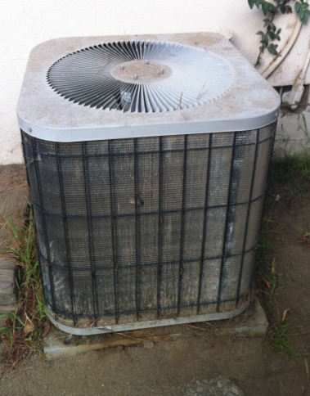
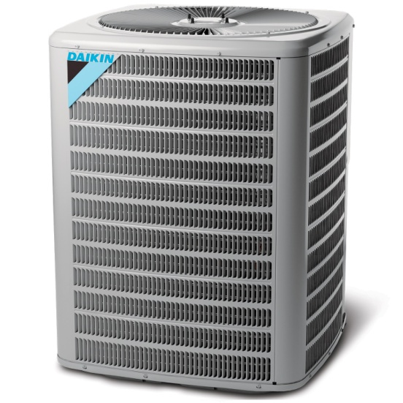

Technician Selling Skills
Technician Soft Skills
Repair vs. Replacement
Do a Cost Comparison
  Cost of ownership of existing system for next 5 years
  Compare to a higher efficiency unit
Costs to keep the current system running are typically well over $1,000
vs.
Repair +
Ownership
New System
Notes:
The final subject we are going to look at is when and how should you recommend that the customer consider the option of replacing their system rather than repairing it. One of the keys to knowing when it's a good time to suggest the customer consider replacement is doing a cost comparison. Often it is more financially feasible and effective for homeowners to replace their existing units instead of paying for repairs. One thing you want to do is review the cost of ownership for the existing unit over the next five years add up the cost of repairs today plus utility overpayments, based on current fuel prices and local annual runtimes over five years, then compare this amount to a higher efficiency unit using a cost comparison tool. Costs are typically well over $1000 to keep the current system running. This factor alone could be enough to convince some homeowners to consider replacement.

Slide 38
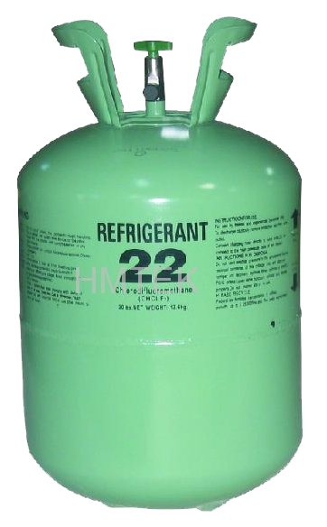
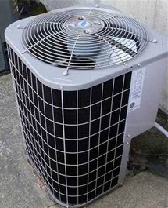
Technician Selling Skills
Technician Soft Skills
Repair vs. Replacement
Other issues to consider…
Does existing unit contain R-22?
Is any warranty left on the existing unit?
Is the existing unit over 10 years old?
Notes:
Here are several other issues to consider. One is whether the customer's existing unit contains R-22 refrigerant. Aside from the environmental aspect of replacing an R-22 system, keep in mind that the EPA's clean air act required reduction of R-22 by 2015 and that all R-22 production ends in 2020. Of course as a result, R- 22 prices have risen significantly and they will only go higher in the future.
Second, consider whether there's any warranty left on the existing unit. A new unit means a totally new warranty and consumers value warranties because they provide peace of mind.
Third, consider the age of the existing unit, keeping in mind the average life expectancy for a typical unit in your area. Generally, a unit that is over 10 years old is a good candidate for replacement.

Slide 39

Technician Selling Skills
Technician Soft Skills
Repair vs. Replacement
Review homeowner’s comfort level and any existing IAQ issues
2 stage cooling systems run longer on lower stage / dehumidify better than single stage
2 stage cooling systems provide even temperatures with fewer start-stops
2 stage gas heating provides a more constant temperature / longer period to add humidity
Variable speed motors are quieter / allow for better IAQ filtration
Across the country, duct work in homes is in poor condition
Notes:
Finally, review the homeowner’s comfort level and any existing IAQ issues within the home. Keep in mind the following:
2-stage cooling systems run longer on the lower stage and dehumidify better than single state units
2-stage cooling systems provide even temperatures with fewer start-stops, reducing wear and tear on the system
2-stage gas heating provides a more constant temperature and a longer period to add humidity during the cycle
Variable speed motors are much quieter and allow for better IAQ filtration
Ductwork in homes across the nation is in poor condition and studies have shown that the majority of systems are losing 30% or more of their capacity, translating into a loss of $.33 of every utility dollar, not to mention the loss of comfort.

Slide 40
Technician Selling Skills
Technician Soft Skills
Repair vs. Replacement
Go over your findings with the customer
Remember, it’s not your job to decide for the customer
Ask if a comfort advisor can come by to discuss replacement options
Notes:
If you conclude that it would be in the customer's best interest to consider replacement, go over your findings with the customer. Remember that it is not your job to decide for the customer - you are only making a recommendation, but you are providing the customer with information to help them decide the best course of action. If the customer is interested in looking further at the possibility of replacement, ask if a comfort advisor can come by the home to discuss replacement options. If not, place the customer’s name into a tickler file for future cold calling.

