Slide 2
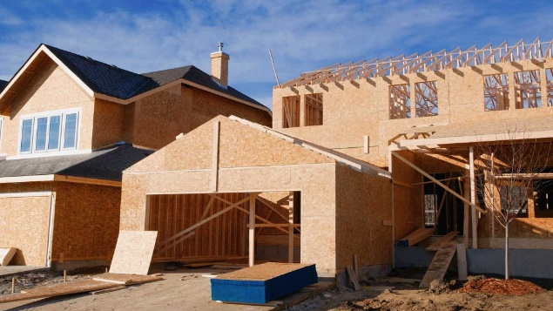
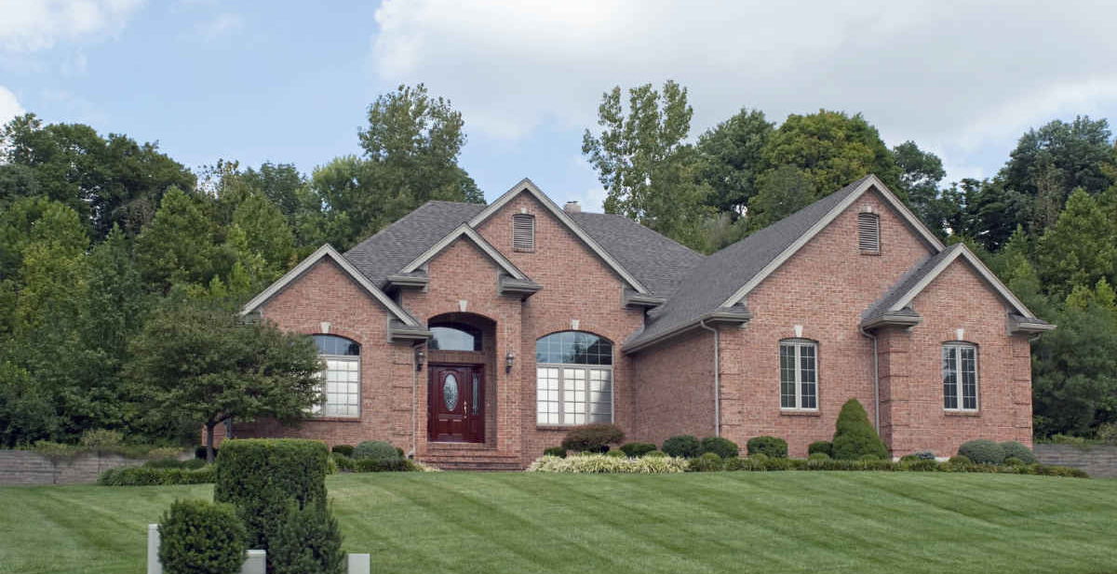
Understanding Sizing and Balancing
Understanding Sizing & Balancing
Objectives
In this course, you will learn about:
The benefits of proper sizing and balancing of HVAC equipment and ductwork
The importance of proper placement of equipment
The importance of proper sizing and installation of refrigerant line sets
Other factors influencing efficiency of the HVAC system

Slide 3
Importance of Proper Sizing & Balancing
Understanding Sizing & Balancing
Introduction
Efficiency of HVAC system depends on:
Selection & sizing of equipment
Location of equipment
Duct system & airflow
Refrigerant charge
Refrigerant line sizing and installation
Thermostat style, location, and adjustment
Notes:
The efficiency of an air conditioning system is greatly dependent on six factors: the selection and sizing of the equipment; the location of the equipment and the installation; the duct system and its air flow settings; the charge in the system; the sizing and installation of the refrigerant line; and the thermostat style, location, and adjustments. Let’s take look at these factors. We will be focusing especially on the importance of proper sizing and balancing of the system but will touch on the other relevant factors contributing to its overall efficiency.

Slide 4
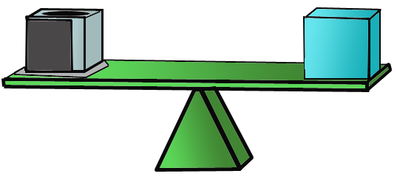
Sizing HVAC
Understanding Sizing & Balancing
Size to match cooling load
For greatest efficiency, equipment must be sized to match cooling load on conditioned space
Too often, sizing is done without adequate thought to accuracy
Equipment Capacity
Cooling Load
Notes:
No amount of professional technician effort can make up for an air conditioner that has been poorly selected and sized. For the greatest efficiency in a finished installation, the equipment must be sized to match the cooling load on the conditioned space. Unfortunately sizing is too often done without adequate thought to accuracy.

Slide 5

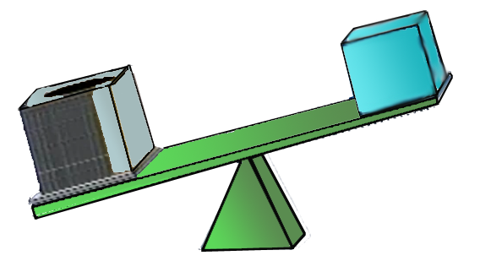
Sizing HVAC
Understanding Sizing & Balancing
Avoiding errors in sizing
Avoid rough estimates and “rules of thumb”
Don’t size based on similar jobs
Don’t size using the size of existing equipment
Don’t use elevated design temperatures
Measure – Don’t guess!
Typical result: OVERSIZING
Notes:
Don’t use rough estimates or imprecise rules of thumb. Don’t base sizing on similar jobs or neighboring homes. Don’t size replacement units based on the size of the unit that is being removed. When a calculation is done, don’t use design temperatures in cooling that are higher than necessary. Do measure spaces rather than estimating. Often the result of these practices is a unit that is oversized. Equipment costs rise - maybe too high to get the job. Equipment cycles too often, causing customer complaints. Humidity control is lost, leading to higher indoor humidity. Space temperatures swing more widely than they should. Customers are uncomfortable and complaints increase. One of the big losers is efficiency of the final installation.

Slide 6
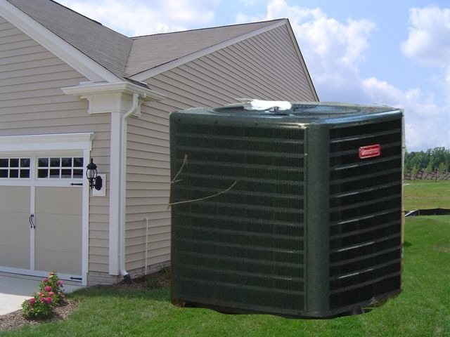
Sizing HVAC
Understanding Sizing & Balancing
Consequences of oversized equipment
High equipment costs
Short cycling
Ineffective humidity control
Large swings in temperature
Uncomfortable customers
Low efficiency
Notes:
Equipment costs rise - maybe too high to get the job. Equipment cycles too often, causing customer complaints. Humidity control is lost, leading to higher indoor humidity. Space temperatures swing more widely than they should. Customers are uncomfortable and complaints increase. One of the big losers is efficiency of the final installation.

Slide 7
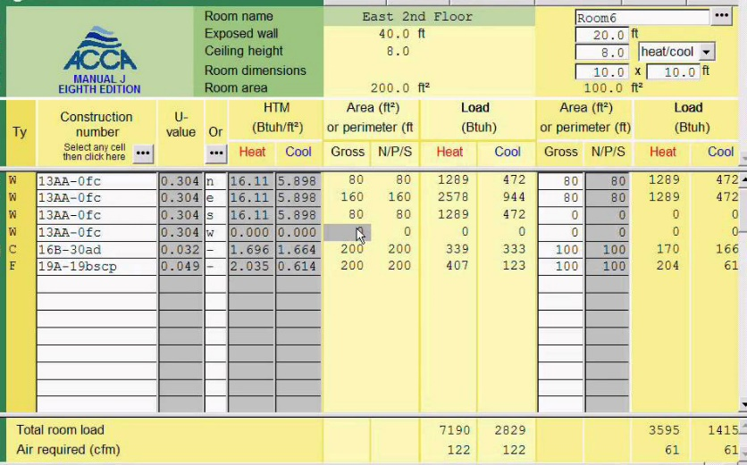
Sizing HVAC
Understanding Sizing & Balancing
Benefits of accurate load calculation
Efficiency increases
Equipment lasts longer when well maintained
Comfort is improved
Utility costs are lowered
Air balancing of the system is easier for the technician
Customers are more satisfied
Notes:
Accurate load calculation and sizing yields many benefits. Efficiency increases; equipment lasts longer when well-maintained; comfort is improved; utility costs are lowered; air balancing of the system is easier for the technician; and customers are more satisfied.

Slide 8
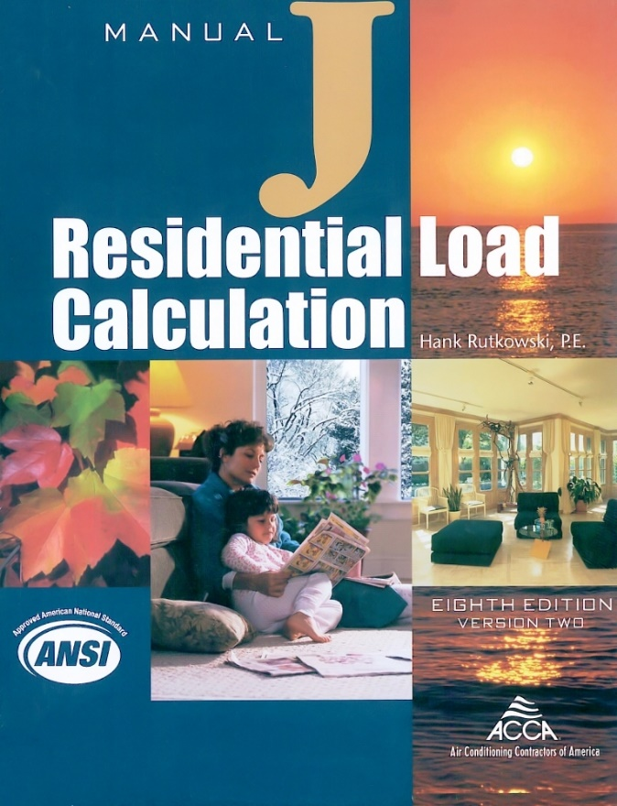
Sizing HVAC
Understanding Sizing & Balancing
Manual J
Tool of choice for most technicians to do a load calculation
Electronic versions are available
Notes:
Manual J is the tool of choice for most technicians to do an accurate load calculation. Electronic versions of the manual are also available for use in the field.

Slide 9
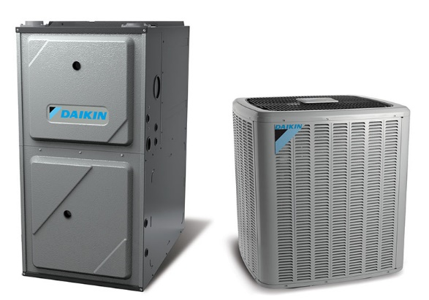
Sizing HVAC
Understanding Sizing & Balancing
Selecting equipment to match the load
Once load is calculated – both latent and sensible…
Select equipment matching total sensible with a maximum safety of about 10%
Do not oversize above the 10% tolerance
According to EPA, oversizing can lead to efficiency loss of as much as 10%
Notes:
Once the load is calculated, both latent and sensible, select equipment that matches the total sensible with a maximum safety of about 10%. Do not oversize above the 10% tolerance. Make sure the airflow in the equipment selected can handle the total sensible load. According to the EPA, oversizing of equipment can lead to efficiency loss of as much as 10%. Accurate sizing and selection leads to high and efficient equipment performance. Make it your first step to improve operating efficiency.

Slide 10
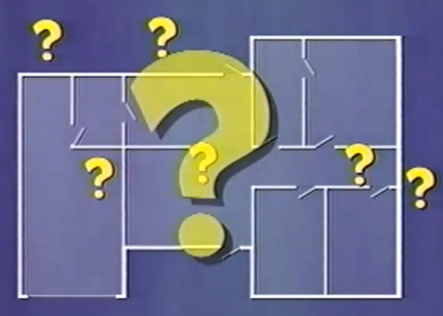
Equipment Location
Understanding Sizing & Balancing
Impact of equipment placement
When technician has some input into the location of equipment, use that say wisely
Location of indoor and outdoor equipment can have a major effect on efficiency of the system
Notes:
Now let’s look at the next factor – location of equipment. In many installations, the technician has little input into the location of the equipment used for cooling. In many other cases the technician does have some say and should exercise that say wisely. The location of both indoor and outdoor equipment can have a major effect on the efficiency of an installed system. Equipment location can affect efficiency in several ways.

Slide 11
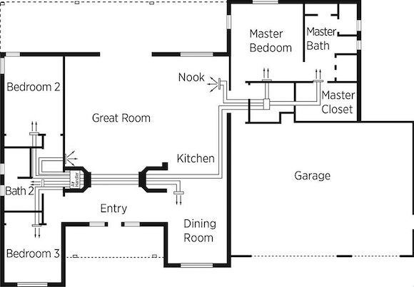
Equipment Location
Understanding Sizing & Balancing
Indoor equipment
Keep duct runs short
Plan efficient and quiet airflow
Allow easy service access
Notes:
Indoor equipment should be located to cause the shortest runs of ductwork. Ducts should be routed for efficient and quiet airflow. Indoor equipment should be located within easy service access. A unit that is hard to get to will be a unit probably not maintained properly.

Slide 12
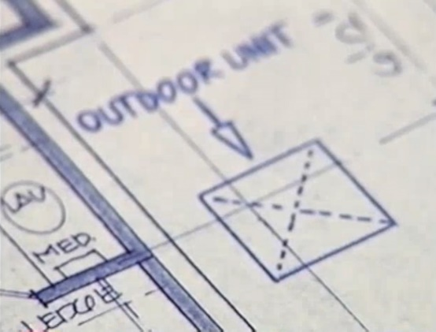
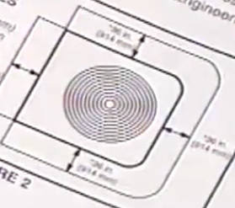
Equipment Location
Understanding Sizing & Balancing
Outdoor equipment
When possible, locate the outdoor unit on the north or east side
Meet minimum clearances specified by manufacturer
Follow-up with customer to make them aware that shrubs and bushes must be maintained with minimum clearance to the condensing unit
Notes:
On the outdoor unit, the big factors are location of the condensing unit and clearance around the unit. Whenever possible, locate the outdoor unit on the north or east side of the structure. This will lower condenser pressure and raise operating efficiency. At installation, ensure adequate clearance by locating the equipment to meet the minimum clearances specified by the manufacturer. Long term, make sure the unit stays clear through proper landscaping. Follow-up with the customer to make them aware that shrubs and bushes must be maintained with a minimum clearance to the condensing unit.

Slide 13
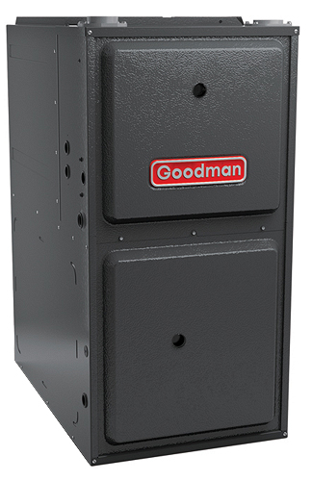
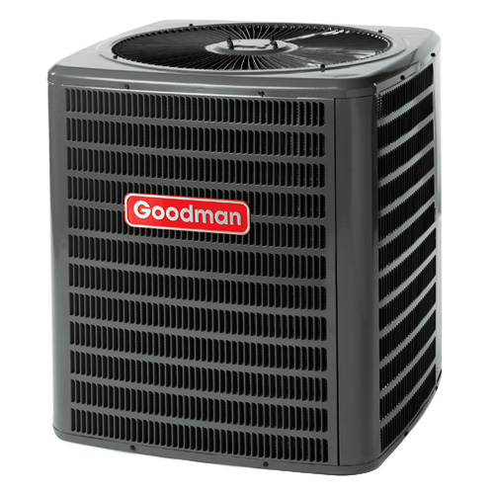
Duct System & Airflow
Understanding Sizing & Balancing
Good airflow & equipment location
Good airflow foundation begins with location of equipment
Well-designed duct system depends partly on placement of indoor unit
Outside – clear air stream through the condenser is a must for efficient heat transfer
Notes:
To start a good airflow foundation at both the indoor and outdoor equipment, pay special attention to the location of the equipment. A good start for a well-designed duct system is the location of the indoor unit. Outside, a clear air stream through the condensing unit is a must for efficient heat transfer through the condensing refrigerant. Prior to construction, do all you can to make the customer or the designer aware of the need for thoughtful equipment location. On the job, place the equipment to build a good environment for efficient airflow, both indoors and outdoors. During planned service, make sure the outdoor unit remains clear and the customer is informed to help keep it clear.

Slide 14
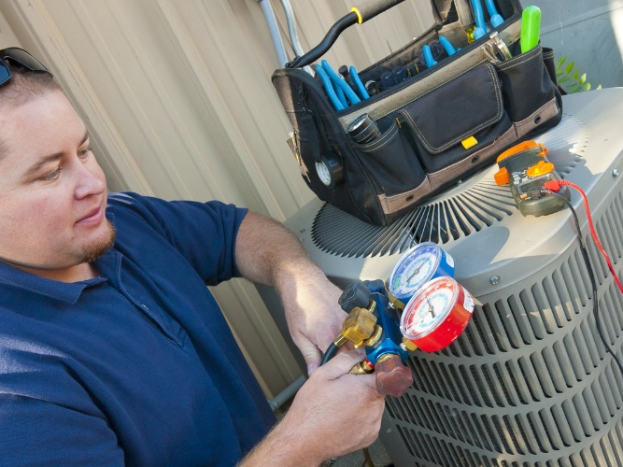
Duct System & Airflow
Understanding Sizing & Balancing
What’s the problem?
Equipment appears to be sized correctly to match the load
All components appear to be operating
The charge appears to be ok
BUT – customer complains:
Poor temperature control
Poor humidity control
High utility bills
A few quick checks lead to a major problem:
Airflow is too low!
Notes:
A professional technician can spot the problem quickly: The equipment appears to be sized correctly to match the load. All components appear to be operating. The charge is okay, maybe. But the customer complains of poor temperature control, poor humidity control and high utility bills. A few quick checks lead the tech to a major problem: in this case, airflow is too low.

Slide 15
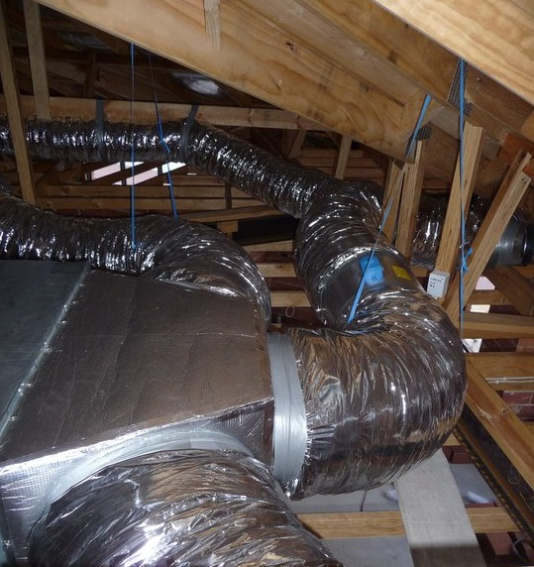
Duct System & Airflow
Understanding Sizing & Balancing
What’s the problem? – cont.
Evaporator is receiving too much refrigerant for the airflow
Liquid might be flooding back
Coil is cold – but not enough air is delivered
In this installation, the ducts are too small for the equipment capacity.
Notes:
The evaporator is receiving too much refrigerant for the airflow. Liquid might be flooding back. The coil is cold, so are the supply temperatures - but not enough air is delivered. In this installation, the ducts are too small for the equipment capacity. The fix will be expensive, probably, for the homeowner - maybe even for the installing dealer.

Slide 16
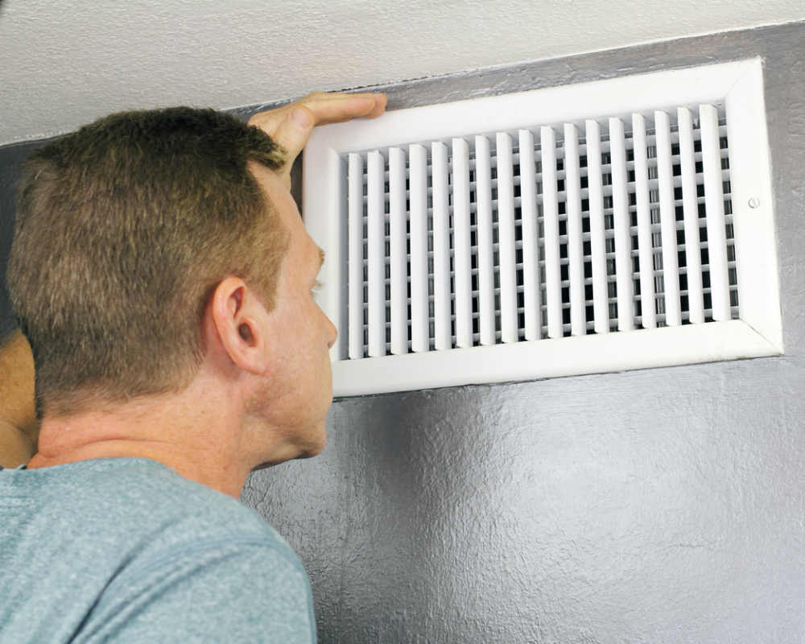
Duct System & Airflow
Understanding Sizing & Balancing
Problems from poor airflow and duct design
Efficiency loss
Total CFM is too low
Installed cooling capacity drops
Latent cooling control is lost
Uncomfortable humidity levels
Compressor is less reliable
Notes:
Airflow and duct sizing are not something to take lightly, but just a small amount of care and judgment upfront can solve many problems. Efficiency loss is one of those problems, but there are others. If airflow is too low, installed cooling capacity drops. Latent cooling control is lost, leading to uncomfortable RH in the conditioned space. Compressor reliability is threatened.

Slide 17
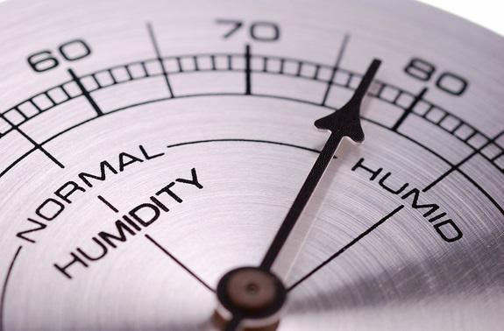
Duct System & Airflow
Understanding Sizing & Balancing
Problems from poor airflow and duct design
Total CFM is too high
Less dehumidification
Uncomfortable humidity levels
Air leakage and capacity loss
Lower blower efficiency
Higher operating costs
Notes:
If airflow is too high, the humidification drops with increased and uncomfortable RH in the conditioned space. Air leakage is more probable with higher likelihood of capacity loss. Blower efficiency drops. Higher operating costs are more likely.

Slide 18
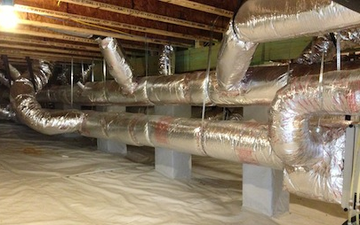
Duct System & Airflow
Understanding Sizing & Balancing
Keys to proper airflow design
Duct sizing
Connection, sealing, & insulation
Duct balancing
Notes:
Providing for proper airflow falls into three categories:
Sizing the ducts to match the total CFM and air velocity needs of the load
insulating and sealing ducts to prevent heat transfer and leakage; and
adjusting and balancing the duct system to deliver the designed airflow.

Slide 19
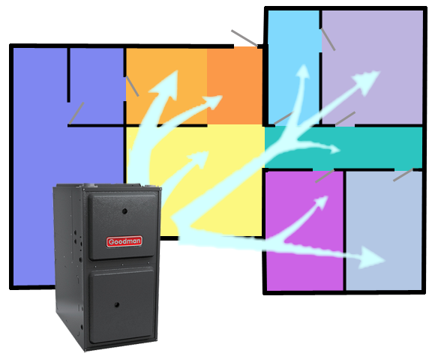
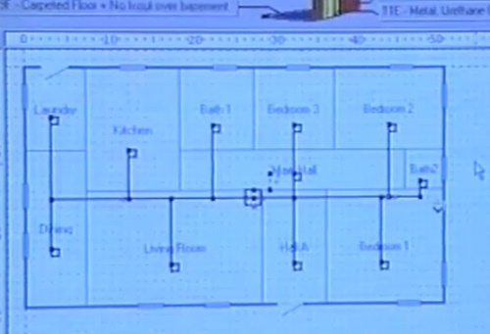
Duct System & Airflow
Understanding Sizing & Balancing
Duct sizing
Manual J tells you the total CFM required to match the total sensible load
Typically, total CFM is between 350 and 450 per ton of cooling
Total CFM is divided in proportion to cooling load of each room
Precise calculations = supply blower and duct design that operate with optimum efficiency
Each duct run laid out to deliver required CFM at proper velocity with minimum thermal losses and leakage
Notes:
The load calculations of Manual J tell the technician the total CFM required to match the total sensible load. Typically, total CFM is between 350 and 450 per ton of cooling. The total CFM is divided in proportion to the cooling load of each room. These precise calculations will deliver the benefit of the supply blower and duct design that operate with optimum efficiency. Each duct run is then laid out to deliver the required CFM at the proper velocity with minimum static pressure loss.

Slide 20
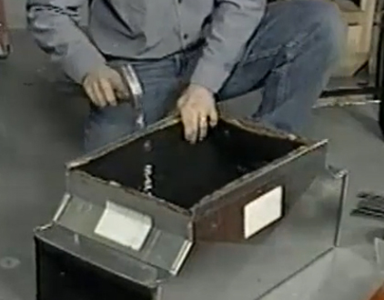
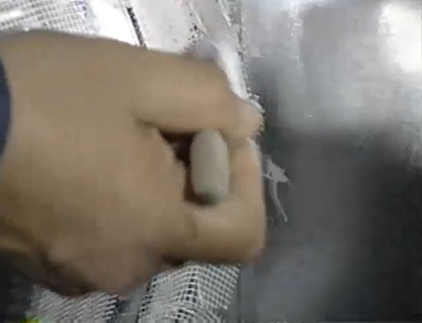
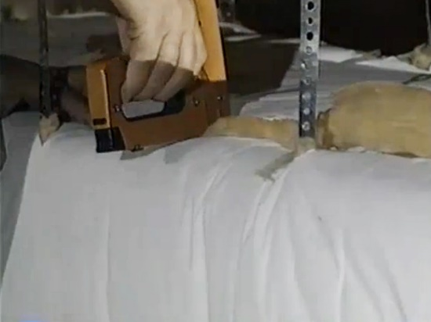
Duct System & Airflow
Understanding Sizing & Balancing
Connection, sealing, & insulation
Construct ducts to minimize thermal loss and leakage
Follow manufacturer recommendations and Manual D for guidelines on installation
Connect and seal ductwork
Insulate wherever possible
If ductwork must be run outside the structure, make sure it’s insulated & weatherproofed
Notes:
Ducts should be constructed to minimize thermal losses and leakage. Follow the recommendations of the manufacturer and Manual D for guidelines on installation requirements. Ductwork should be connected and sealed using widely available guidelines for connecting and sealing the specific ductwork used. Insulate wherever possible to minimize heat transfer on both the supply and return ductwork. If ductwork must be run outside the structure, make sure it’s insulated and weatherproofed.

Slide 21
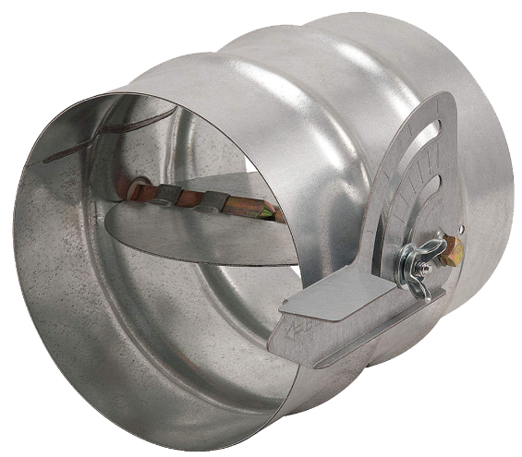
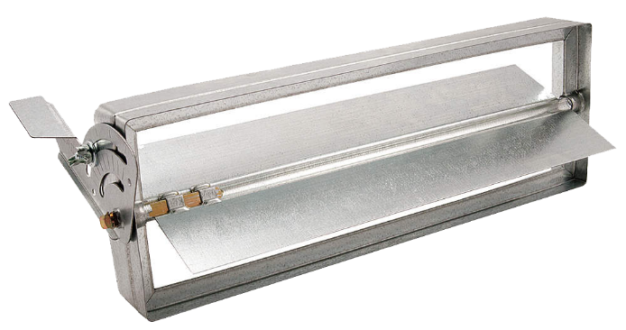
Duct System & Airflow
Understanding Sizing & Balancing
Duct balancing
Adjust and balance for the CFM required in all spaces that must be cooled
If possible, include balancing dampers
Notes:
In the final stage for achieving high efficiency with the duct system, make sure the system is adjusted and balanced for the CFM required in all the spaces that must be cooled. If at all possible, include balancing dampers in the duct system to more easily achieve balance.

Slide 22
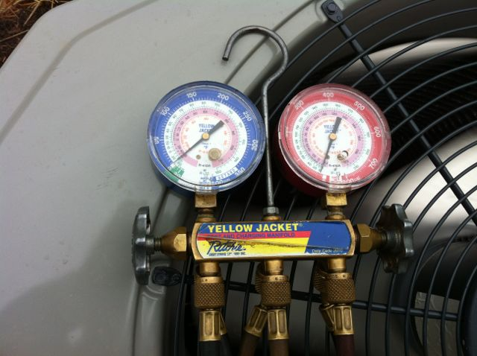
Refrigerant Charge
Understanding Sizing & Balancing
Charge affects efficiency
Check refrigerant charge using correct method
Superheat method for cap tube systems
Sub-cooling method for TXV systems
System with low charge:
Loses capacity & efficiency
Suction gas flow drops
System overcharged:
Loses capacity & efficiency
Possibility of evaporator flooding increases
Liquid flood-back more likely
Notes:
Once the technician is certain airflow is as it should be, refrigerant charge should be checked. One important step is to use the correct method. Too often, rules of thumb are used that might not be appropriate for the system being checked. Be accurate in your measurements. Charge, particularly on newer systems, has a major effect on system efficiency. A system with a low charge loses both capacity and efficiency. Suction gas flow drops, starving the evaporator and compressor of much-needed cooling. A system with an overcharge also loses both capacity and efficiency. The possibility of evaporator flooding increases. Liquid flood-back to the compressor also is more likely to occur. Efficiency losses for cap tube systems that are improperly charged can be as much as 20%. Efficiency losses for TXV systems that are improperly charged could be as much as 5%. Follow the manufacturer’s recommendations for checking charge on any particular system. In general, the superheat method should be used on cap tube systems; the subcooling method should be used on TXV systems. Other methods such as the approach method are often used to double check your selected method and accurately check charge to keep efficiencies up.

Slide 23
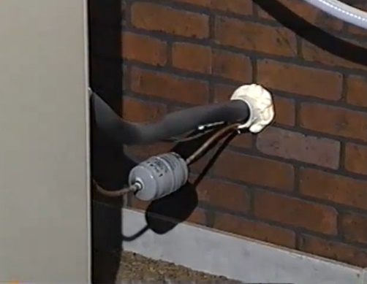
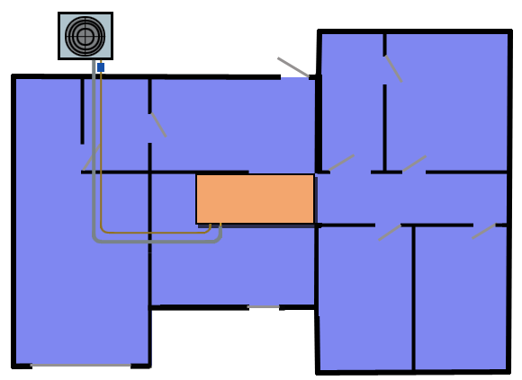
Refrigerant Line Sizing & Installation
Understanding Sizing & Balancing
Sizing guidelines
Typically most manufacturers design equipment for max line length of 50 ft
Suction line – sized to keep pressure drop low but efficiency up
Liquid line – undersized line causes possible liquid flashing with loss of capacity and efficiency
Don’t exceed manufacturer’s max line length
Notes:
At the refrigerant line, there are two factors affecting efficiency: sizing of the lines and fittings, and installation of the line. Typically most manufacturers design equipment for maximum line length of 50 feet. The manufacturer’s max line should not be exceeded unless special pipe sizing and routing is used. Suction lines should be sized to keep pressure drop low but flow efficiency up. Excessive suction line pressure drop causes loss of capacity and efficiency. The same is true of the liquid line. An undersized liquid line causes possible liquid flashing with a loss of capacity and efficiency. For sizing both liquid line and suction line, follow the manufacturer’s guidelines.

Slide 24
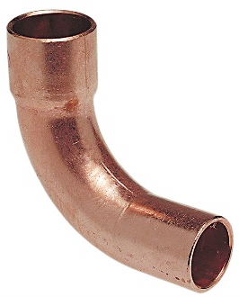
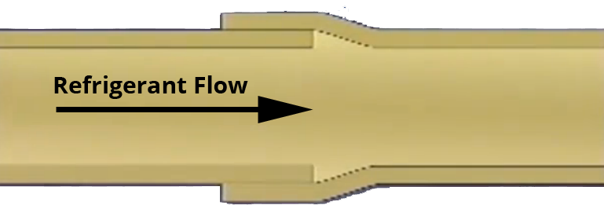
Refrigerant Line Sizing & Installation
Understanding Sizing & Balancing
Installation guidelines
Use long radius elbows
When using swaged fittings, try to put swaged fitting or tube downstream
Insulate suction line with at least 3/8th inch insulation (1/2 inch preferred)
Don’t insulate liquid line unless routed through unconditioned space
Make sure the system has been properly evacuated
Long radius elbow fitting
Swaged fitting
Notes:
When fabricating, use long radius elbows. When using swaged fittings, try to put the swaged fitting or tube downstream of the straight tube or fitting. This will reduce pressure drop and improve efficiency. Insulate the suction line with at least 3/8 inch insulation to reduce heat transfer. Half-inch is preferred. Suction gas that remains cool helps keep compressors operating at lower temperatures and improves efficiency. The liquid line should not be insulated unless it is routed through unconditioned space, such as an attic that is subject to elevated temperatures. For higher efficiency the liquid refrigerant should be as cool as possible before entering the evaporator. Finally, to get maximum efficiency, make sure the system has been properly evacuated and is free of leaks before charging. Air that remains in the system can cause increased head pressure, loss of capacity, and reduced efficiency.

Slide 25
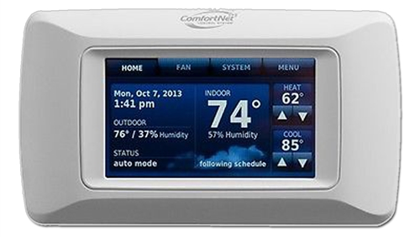
Thermostat Location
Understanding Sizing & Balancing
Proper placement
Mount close to a return
Keep it away from a supply diffuser
Use an interior wall
Avoid close proximity to windows or exterior doors
Notes:
A thermostat works best when properly located. A thermostat working at its best will help keep the system operating at its best. Locate the thermostat on a wall near a return. Locate it away from a discharge register or diffuser. Locate it on indoor wall, never on an exterior wall. Avoid high heat locations such as near a glass window. Don’t let the customer forget the contribution of the thermostat in efficient operation.

