Slide 1
ecoSYS Site Supervisor
Setup & Configuration II

Slide 2
(Instructor Name)
Presented By:
Notes:
Intro
Wednesday, March 13, 2001
2

Slide 3
Housekeeping
Smile Card
No Smoking
Class Length
Portable Phones and Beepers
Rest Rooms
Fire Safety
Notes:
Write name on the front of the smile card in big letters using the sharpie that is making its way around the room.
No smoking in the classroom. Designated smoking area is___.
Class length is -- minutes; no breaks scheduled.. Will commit to finishing on time.
Please make phone calls after class, and switch your phones to the vibrate or silent alert type if possible.
Rest rooms are located ______.
To locate the fire exit...

Slide 4
Course Reference Materials
Participant Manual
ecoSYS Site Supervisor Controller User Guide
ecoSYS Site Supervisor Quick Setup Guide
Notes:
Participant Manual - Please make notes in it, and keep it for future reference.

Slide 5
Course Agenda
Backup, Cleanout, and Restore
Upload a Description File
View Store Status
View/Change Com Ports
View/Change Internet Values
View Licensing
View/Change Localization
View/Change System Values

Slide 6
ecoSYS Site Supervisor Backup, Cleanout, & Restore
Notes:
It is a best practice to backup your Site Supervisor configuration in the event of unintended loss of data, configuration adjustment errors, or any situation where you might need to restore the original settings across the system. In this module we will cover the steps for Site Supervisor backup, cleanout, and Restore.
Intro
Wednesday, March 13, 2001
6

Slide 7
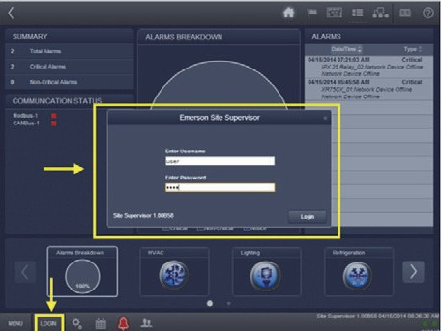
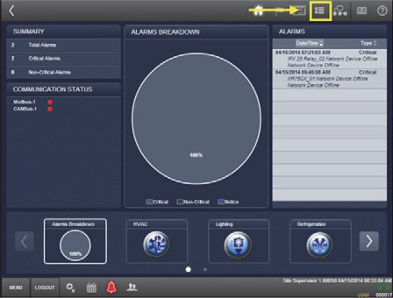
Site Supervisor Backup
Login to Site Supervisor
Click on Site Map
Notes:
To backup the system configuration, first login to Site Supervisor and then click on the Site Map.

Slide 8
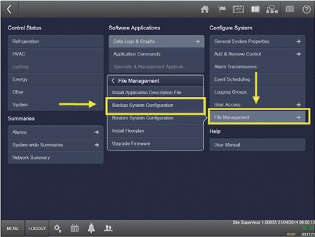
Site Supervisor Backup
Select File Management, then Backup System Configuration
1
2
Notes:
From the menu, select File Management and then Backup System Configuration.

Slide 9
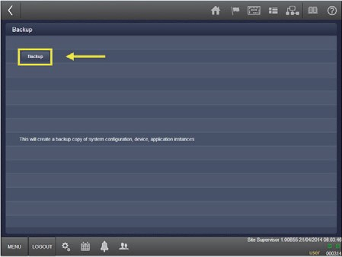
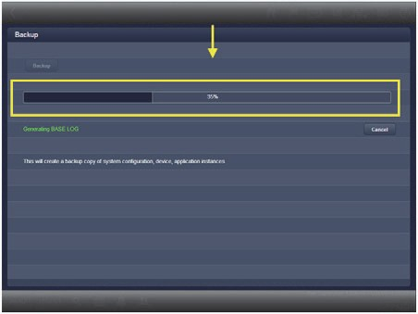
Site Supervisor Backup
Select the Backup button
System will start to backup files – progress is displayed
Notes:
Now, select the BACKUP button.
The system will begin the process of backing up files. A progress bar displays as the backup is created.

Slide 10
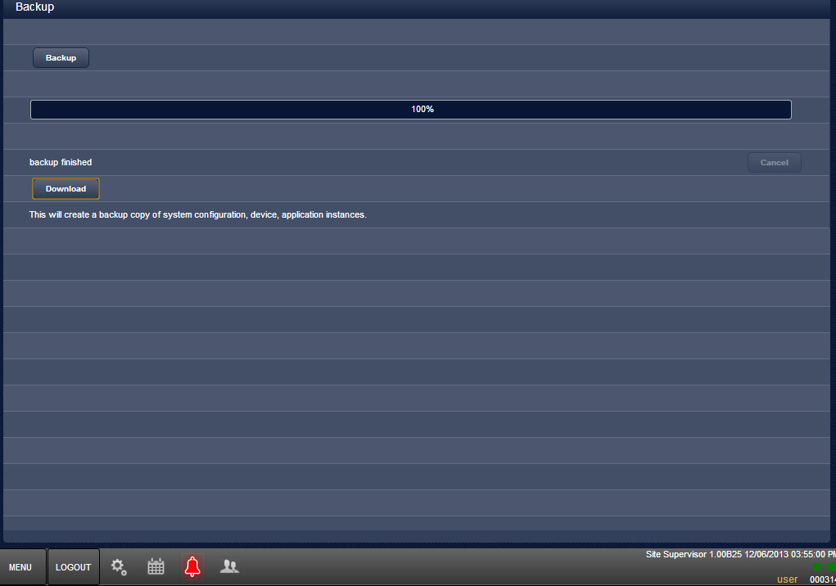
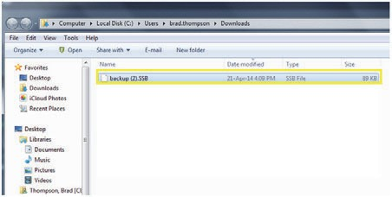
Site Supervisor Backup
When the backup finishes, click on the Download button
Select the location for the backup file
Notes:
When the backup process finishes, click on the DOWNLOAD button so that you can save the backup file. You will be prompted to choose the location where you want to save the file.

Slide 11
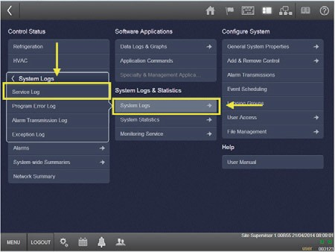
Site Supervisor Cleanout
Login to Site Supervisor, go to Site Map
Select System Logs, then choose System Log
2
1
Notes:
To perform a cleanout, login and go to Site Map. Select the System Logs option from the menu, then choose SYSTEM LOG.

Slide 12
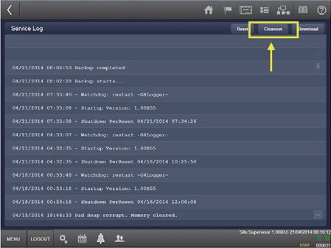
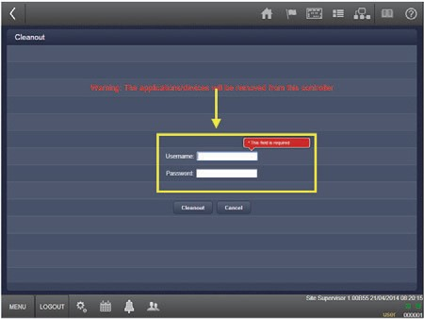
Site Supervisor Cleanout
Click the Cleanout button
Enter username and password, then select Cleanout
Notes:
Next, click on the CLEANOUT button. A box will open asking you to re-enter your credentials. Enter your username and password, then select CLEANOUT.

Slide 13
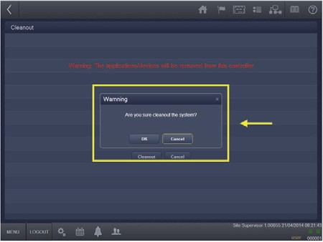
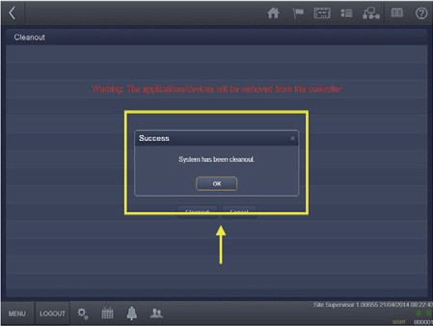
Site Supervisor Cleanout
Click OK to confirm
When cleanout is complete, select OK to continue
Notes:
To confirm that you wish to do the cleanout, click the OK button.
When cleanout has completed, select OK.

Slide 14
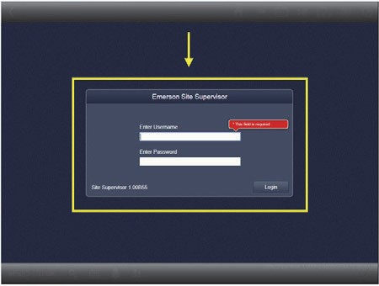
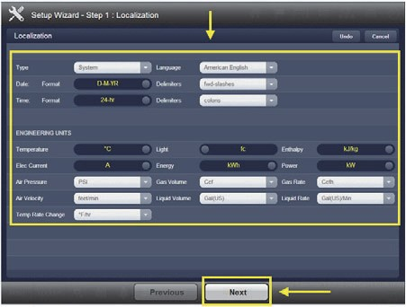
Site Supervisor Restore
On the cleanout screen, enter your username and password.
Enter Localization settings, then select Next.
Notes:
To perform a Restore, navigate to the cleanout screen and enter your username and password.
Enter Localization settings, then select NEXT at the bottom of the screen.

Slide 15
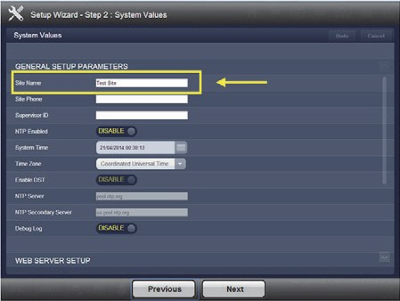
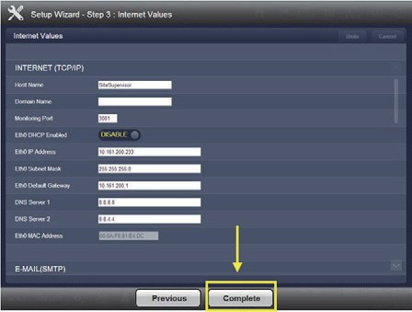
Site Supervisor Restore
On System Values screen, enter the Site Name.
On Internet Values screen, click Complete.
Notes:
On the System values screen, enter the Site Name in the first field.
Select Next, which takes you to the Internet Values screen. On this screen, click COMPLETE.

Slide 16
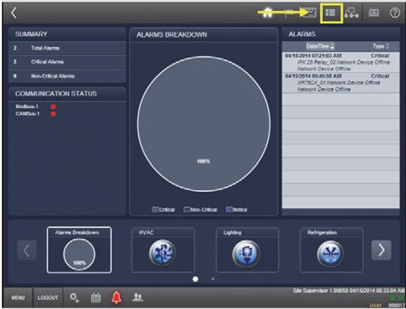
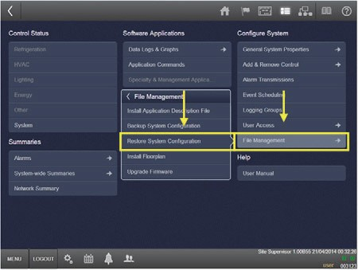
Site Supervisor Restore
From the Home screen, go to Site Map.
Go to File Management, then choose Restore System Configuration.
2
1
Notes:
Back at the Home screen, go to the Site Map.
Choose File Management from the menu, then RESTORE SYSTEM CONFIGURATION.

Slide 17
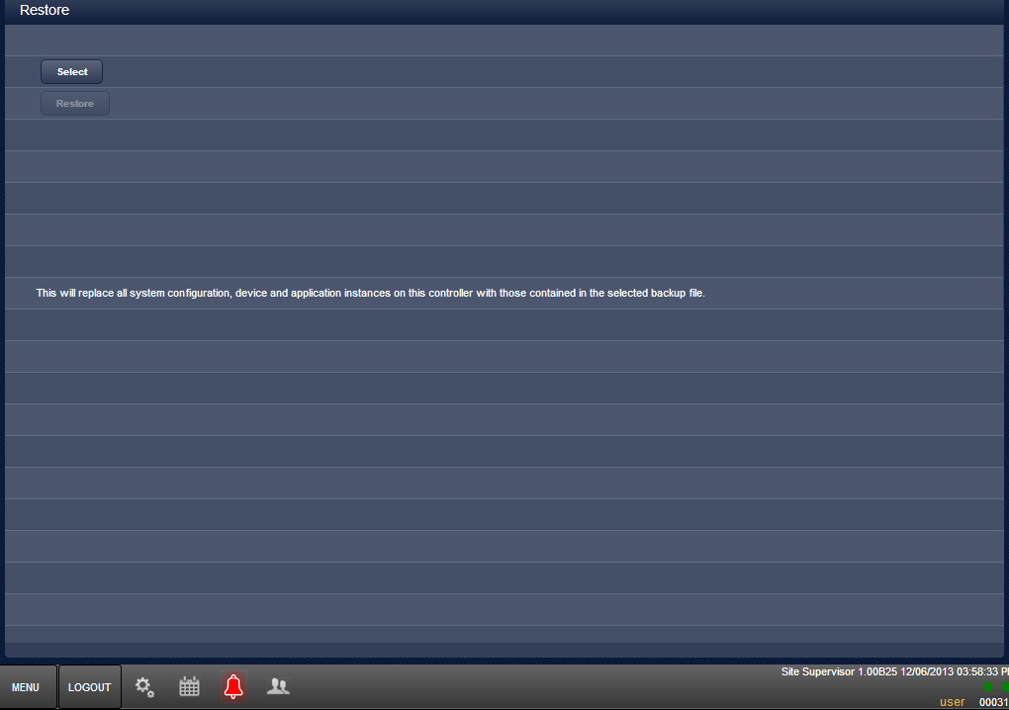
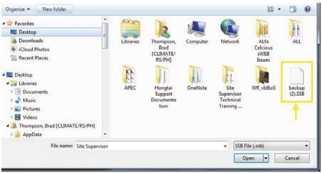
Site Supervisor Restore
Click Select.
Choose the File to be Restored.
Notes:
Now, click on the SELECT button. You will now be prompted to choose the file that you want to restore. Browse to and select the appropriate backup file.

Slide 18
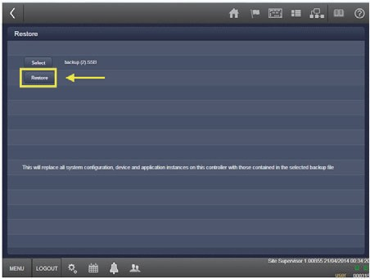
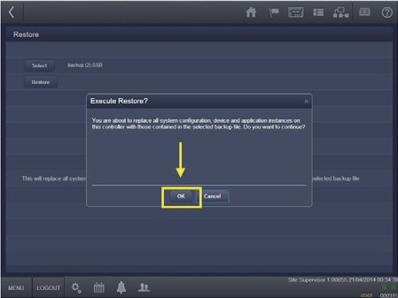
Site Supervisor Restore
Select the Restore button.
Confirm the Restoration by clicking on OK.
Notes:
Next, select the Restore button.
A window will open asking you to confirm that you wish to perform the restore. Click on OK to proceed.

Slide 19
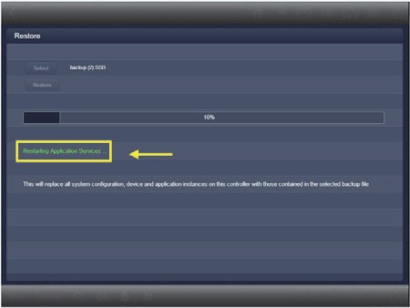
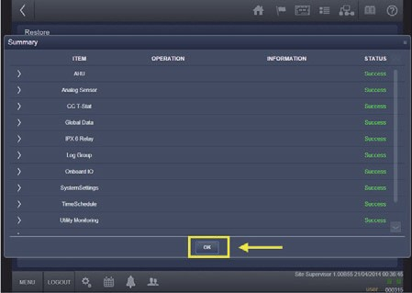
Site Supervisor Restore
Wait for the restoration – progress displayed.
On completion, a summary appears. Click OK.
Select Home to exit.
Notes:
A progress bar will display as the system performs the restore process.
When the process is completed, a summary screen will appear. Click on OK, then select Home to exit.

Slide 20
ecoSYS Site Supervisor Upload a Description File
Notes:
With Site Supervisor, you have the ability to upload an Application Description File in order to quickly set up and configure an application in the system. This module covers the steps for installing a description file.
Intro
Wednesday, March 13, 2001
20

Slide 21
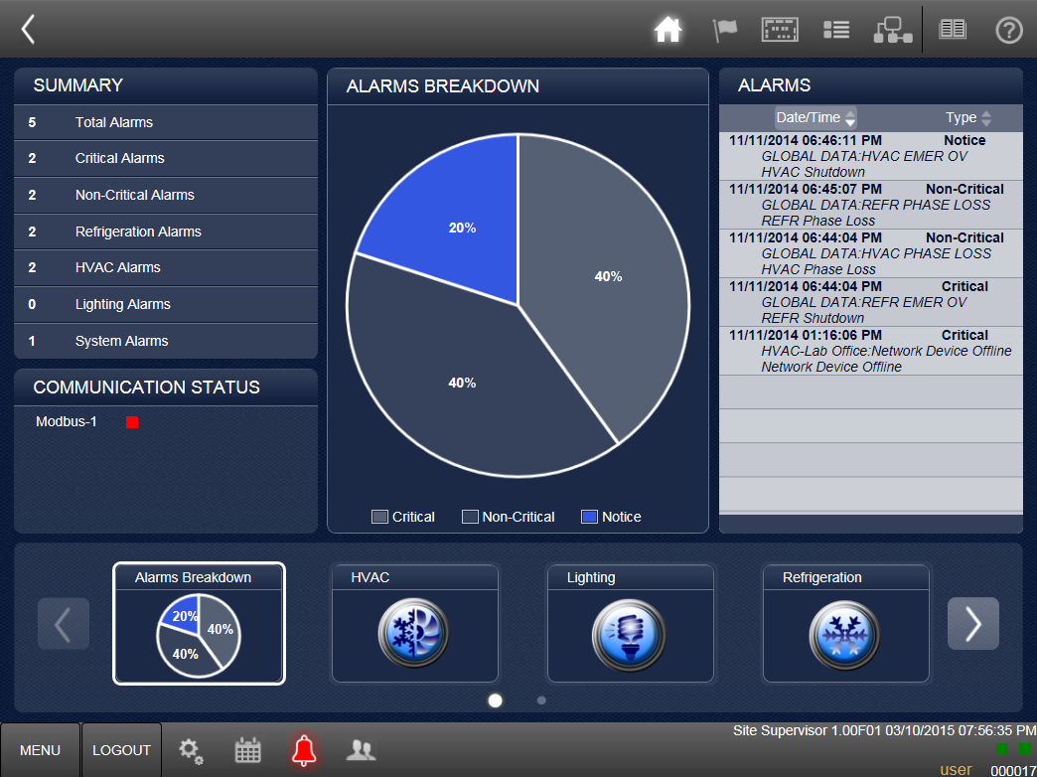
Upload a Description File
To begin, log into Site Supervisor, then go to the Site Map.
Notes:
To begin, log into Site Supervisor and go to the Site Map.

Slide 22
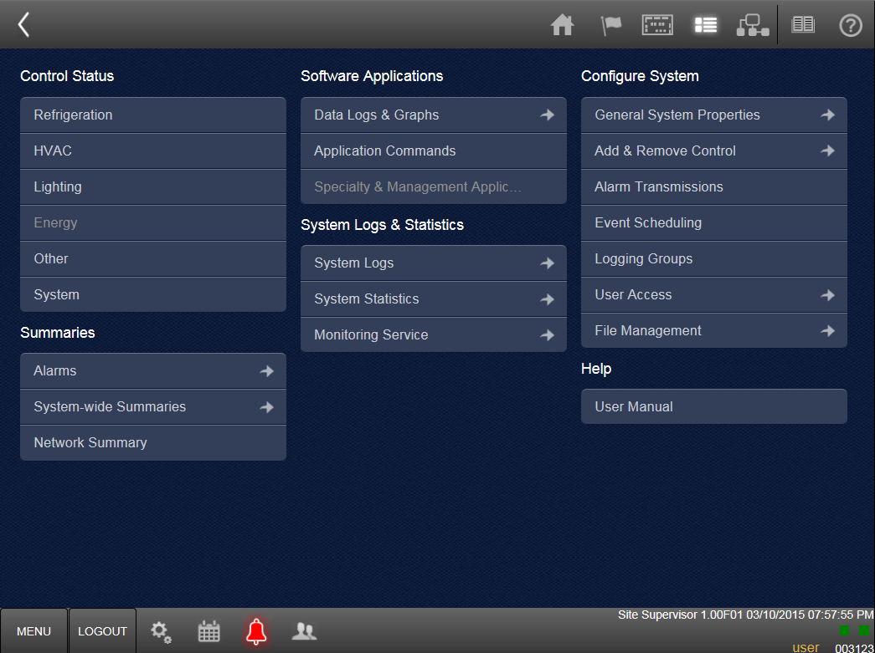
Upload a Description File
On the Site Map screen, choose File Management.
Notes:
On the Site Map screen, choose File Management under “Configure System.”

Slide 23
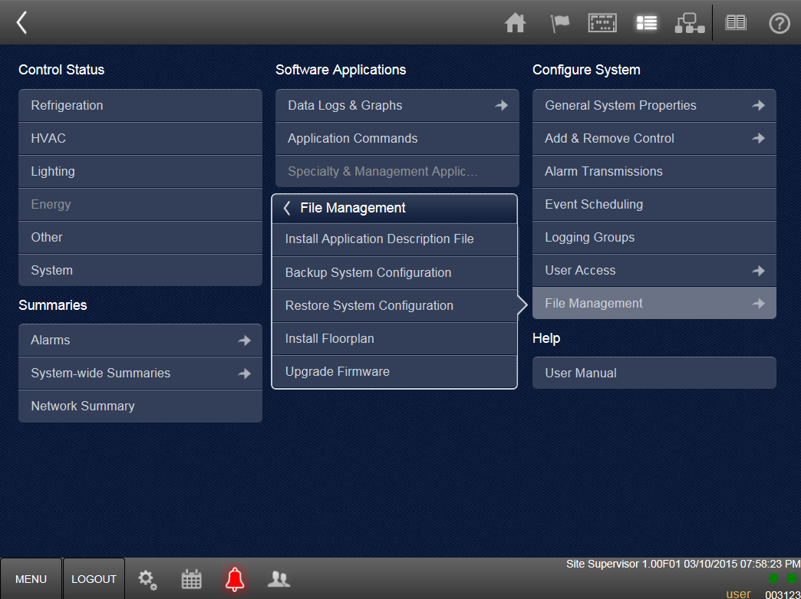
Upload a Description File
Next, click on Install Application Description File.
Notes:
Next, in the File Management box, choose “Install Application Description File.”

Slide 24
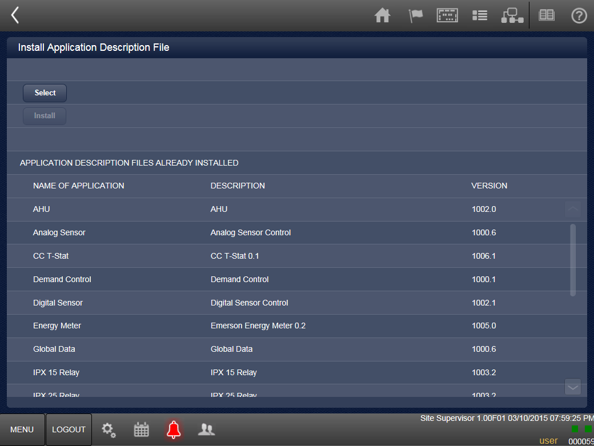
Upload a Description File
Choose the Select button.
Notes:
At the top of the screen, choose the Select button so that you can choose the ADF file you are going to upload.

Slide 25
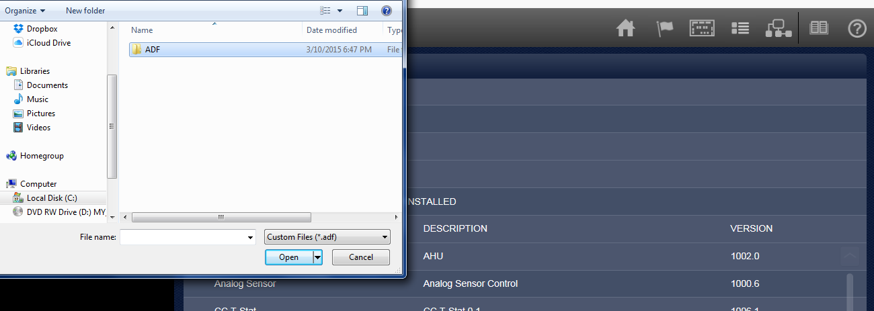
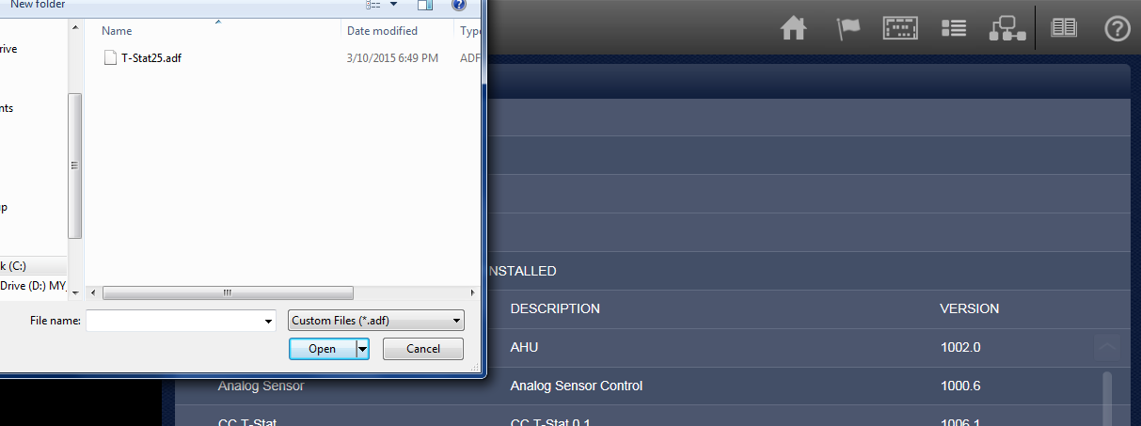
Upload a Description File
Locate the description file (*.adf) in the browse window.
Click the Open button.
Notes:
A browse window will open. Navigate to the description file and select it, then click on the Open button in the browse window.

Slide 26
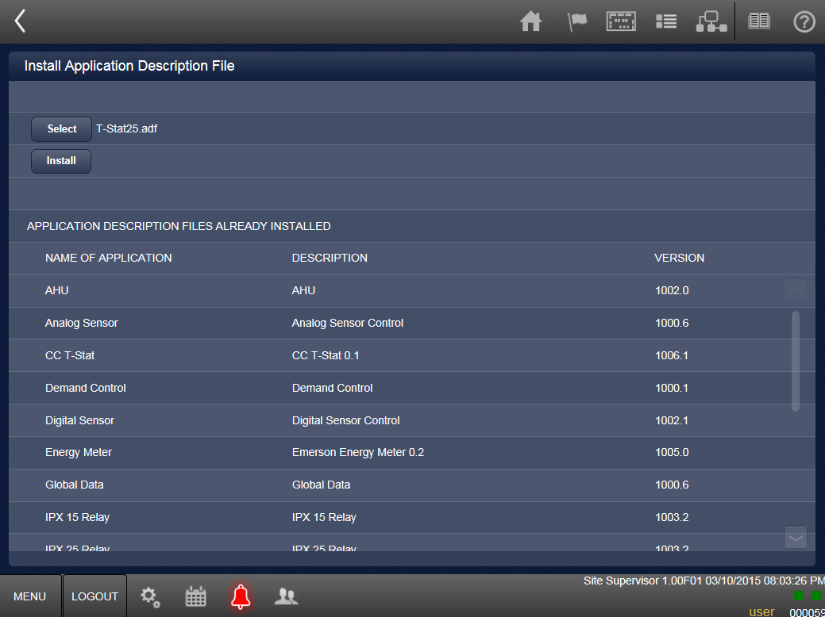
Upload a Description File
Click the Install button.
Notes:
Now, the Install button will be available to select, whereas previously it was shaded. Click on Install.

Slide 27
Upload a Description File
In the confirmation window, choose OK.
The file will now be uploaded.
Notes:
A small window will open asking you to confirm whether you wish to install the description file. Choose OK.
The file will now be uploaded. A progress bar will indicate when the upload is complete and final installation will be confirmed.

Slide 28
ecoSYS Site Supervisor View Store Status
Notes:
One of the basic functions of Site Supervisor is to provide you with the status of the devices and applications connected to and controlled by the system. This module will review several different ways of viewing summary information about the status of applications in your store.
Intro
Wednesday, March 13, 2001
28

Slide 29
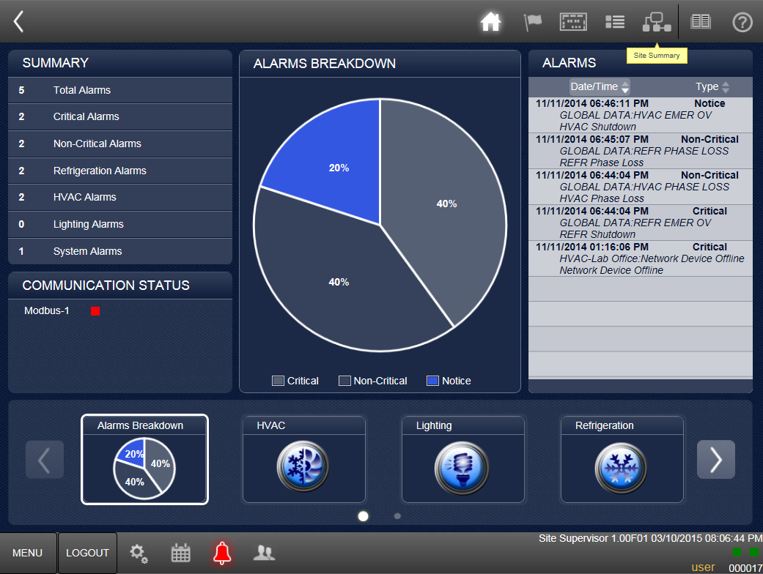
View Store Status
One way to see summary data is to choose the Site Summary icon.
Notes:
There are several ways to get to the various summary data that will allow you to view the status of everything controlled by Site Supervisor. If you want to see an overview of your entire site, you can simply select the Site Summary icon in the top right of the screen.

Slide 30
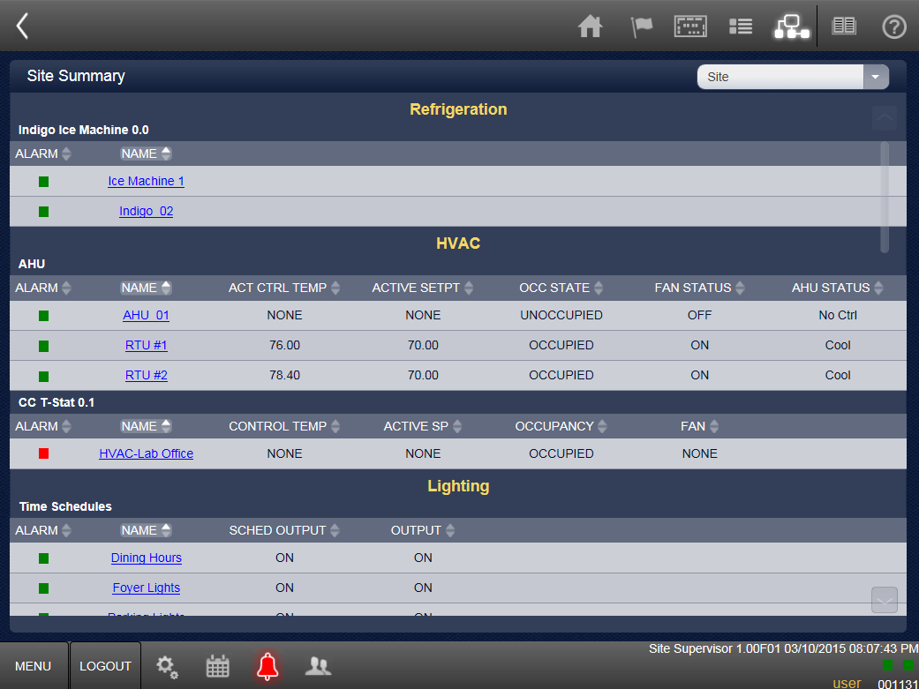
View Store Status
The Site Summary screen gives you a high level view of all applications.
Notes:
The Site Summary screen gives you a high level view of all your applications grouped by application type – Refrigeration, HVAC, Lighting.

Slide 31
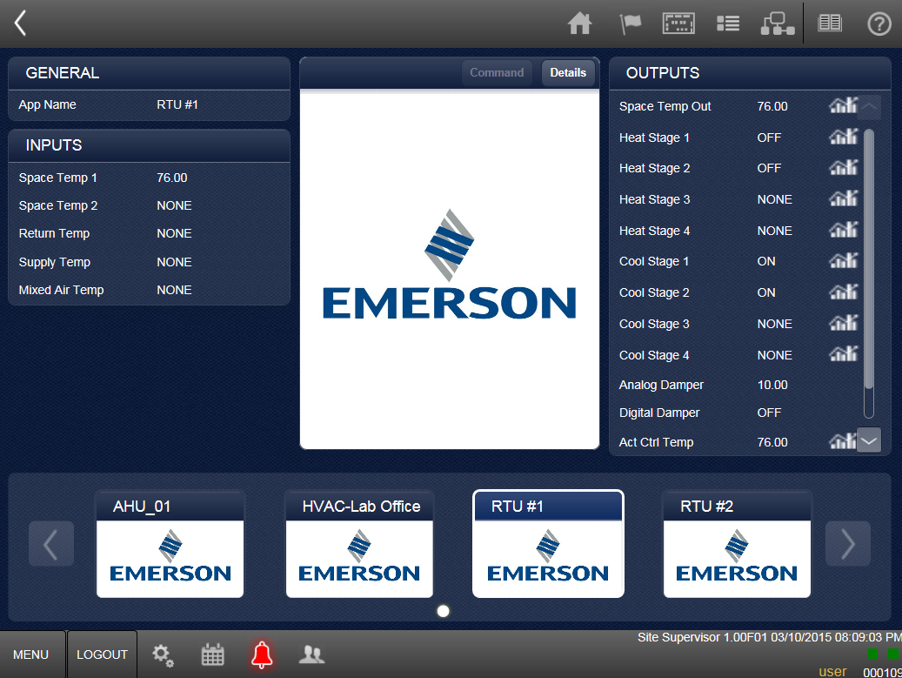
View Store Status
Clicking on one of the applications will take you to the details for that application.
Notes:
If you want to dig more deeply into the details on one of the applications, click on that application and you’ll be taken to a detail screen.

Slide 32
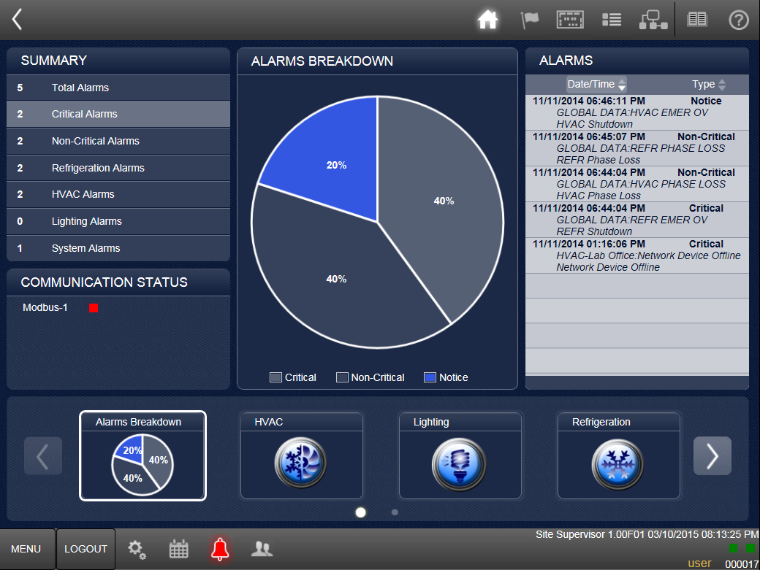
View Store Status
Another place to find status summary information is the Summary panel on the Home screen.
Notes:
Another place you can find some status summary information is in the Summary panel on the Home screen, where you’ll see a summary of system alarms. You can click on any of the alarm categories to go to a detail page.

Slide 33
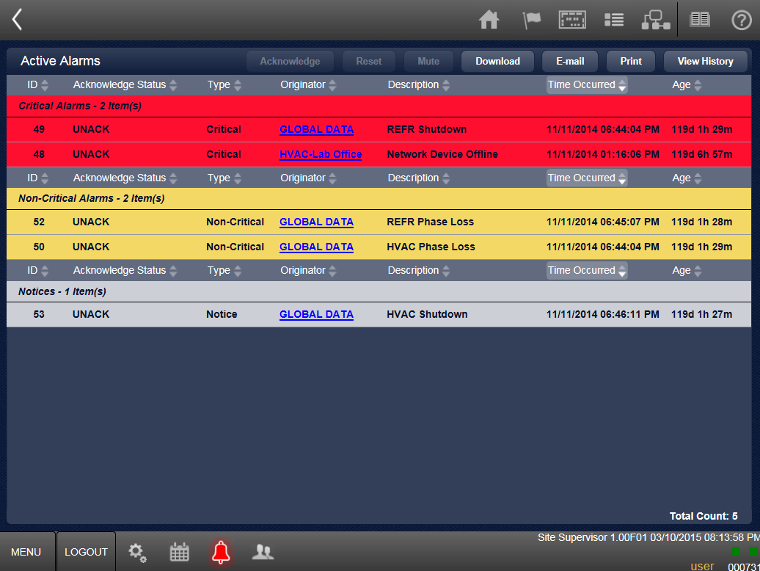
View Store Status
Selecting an alarm category takes you to details.
Notes:
In this onscreen example, we have selected the Total Alarms category from the Summary panel on the Home Page, which takes us to a summary of all current alarms in the system.

Slide 34
View Store Status
You can also go to an application summary by choosing the device type from the Home screen.
Notes:
Another way to get to summary information for a particular application is to choose the device category from the menu bar (?) in the bottom third of the home screen. For example, if we want to see summary HVAC information, we can click on the HVAC icon at the bottom of the screen.

Slide 35
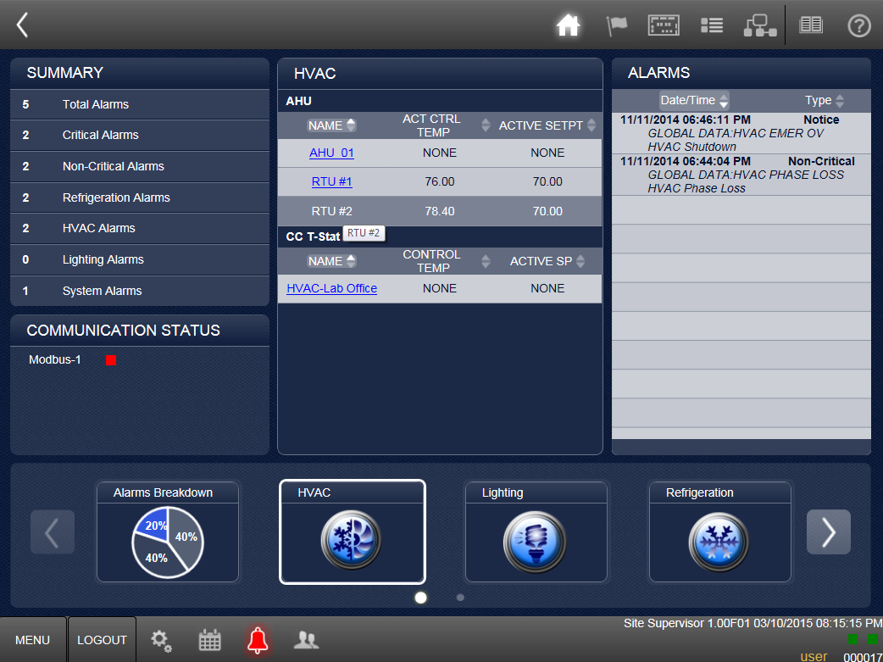
View Store Status
The center panel now shows us summary information for the device applications.
Click on an application for more details.
Notes:
Now, after choosing the device category, the center panel displays summary information about the device applications. You can drill into more detail on an application by selecting the application from the list. For example, we can click on RTU#2.

Slide 36
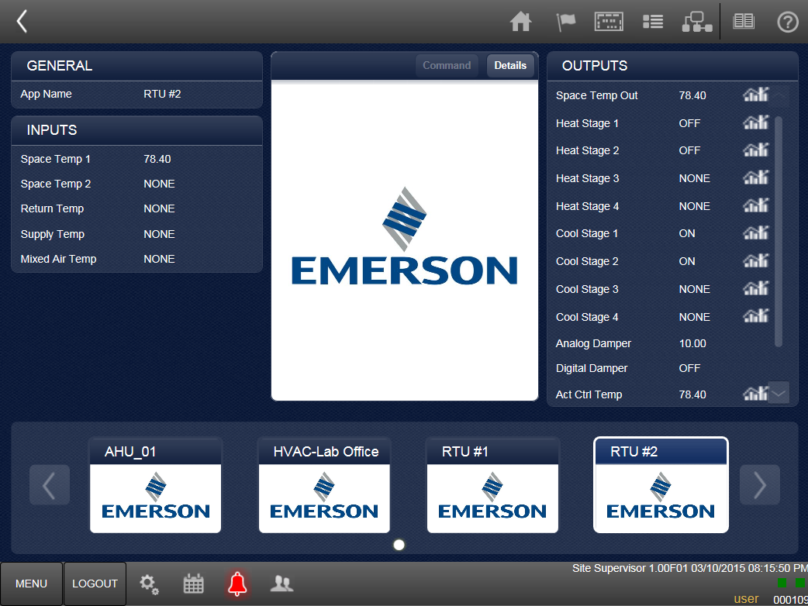
View Store Status
Notes:
Now we are taken to details on the specific application we chose – in the case of our onscreen example, RTU#2.

Slide 37
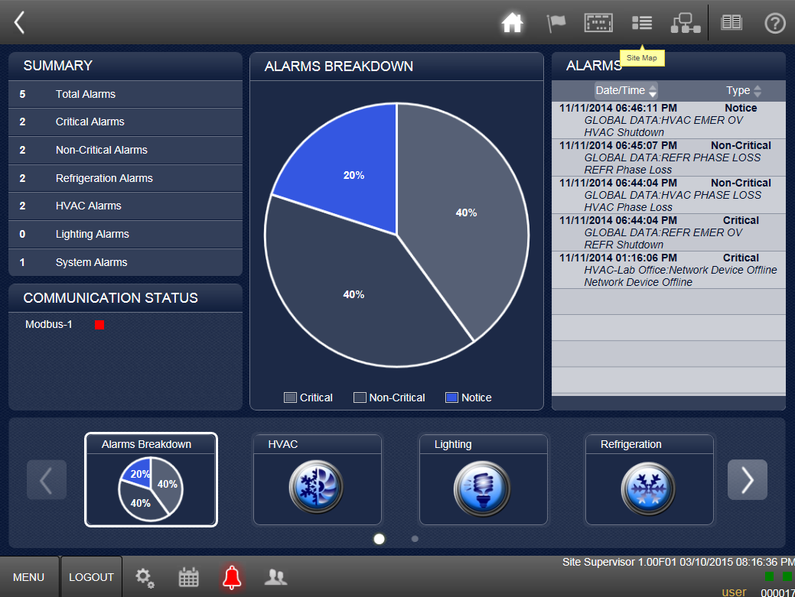
View Store Status
You can also use the Site Map to get to site status information.
Notes:
Finally, you can also use the Site Map to navigate to site status information. From the Home screen, click on Site Map.

Slide 38
View Store Status
You can also use the Site Map to get to site status information.
Notes:
Finally, you can also use the Site Map to navigate to site status information. From the Home screen, click on Site Map.

Slide 39
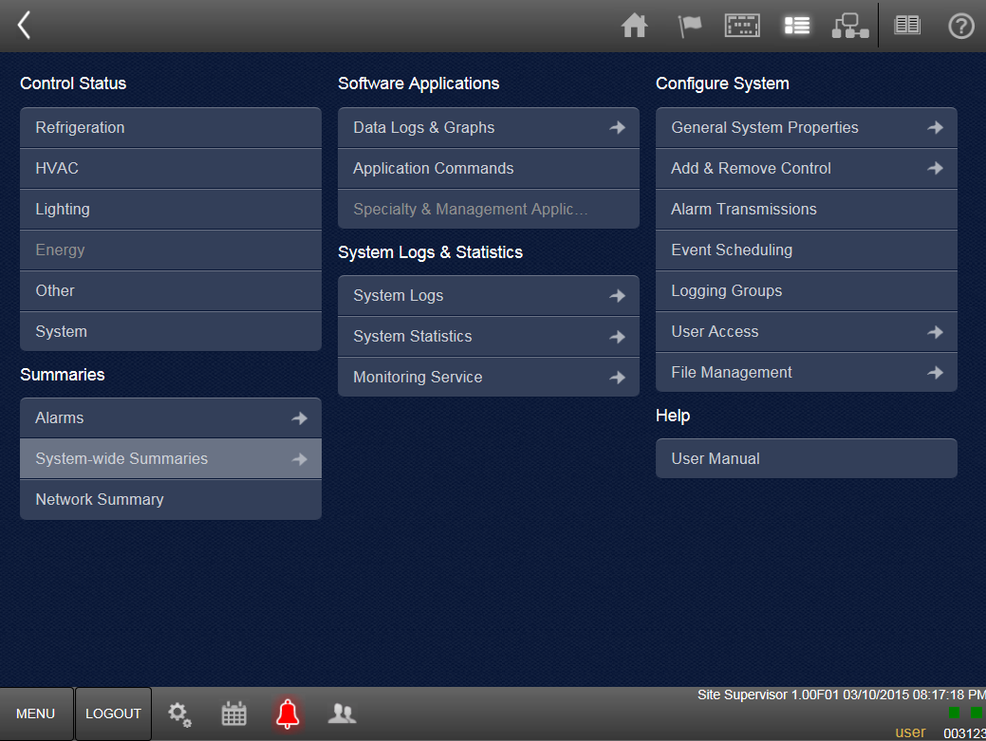
View Store Status
Go to System-wide Summaries.
Notes:
Now, under the Summaries area, click on System-wise Summaries.

Slide 40
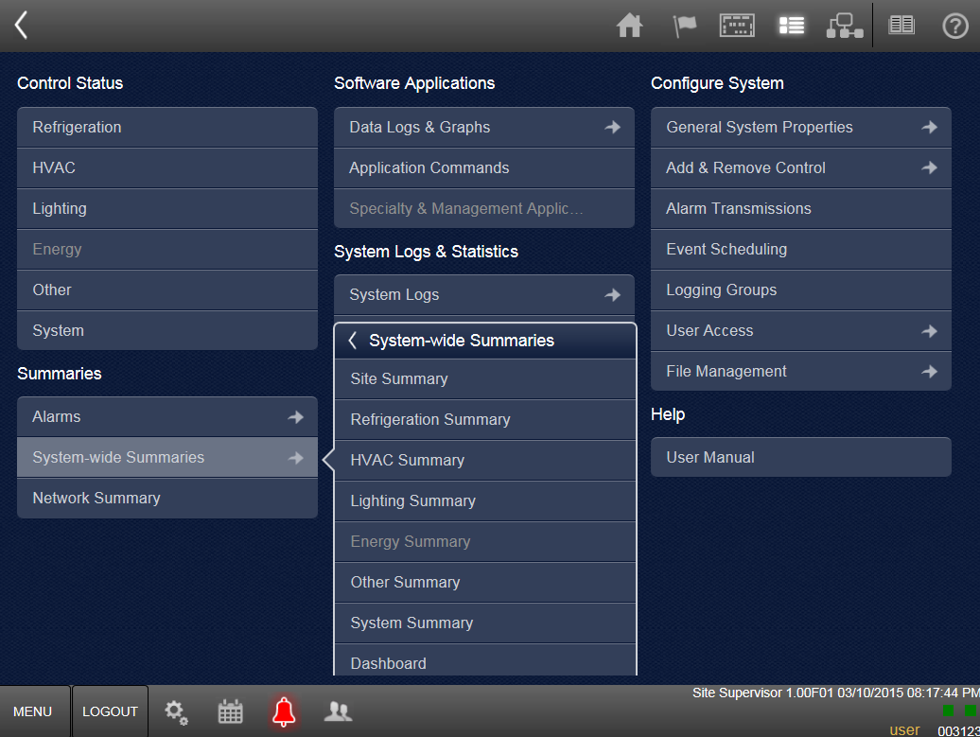
View Store Status
You can choose to go to the Site Summary or you can go to the summary screen for a specific device category.
Notes:
Next, you can choose to go to the Site Summary (the same place we visited earlier) or you can go to the summary screen for a specific device category – Refrigeration, HVAC, or Lighting.

Slide 41
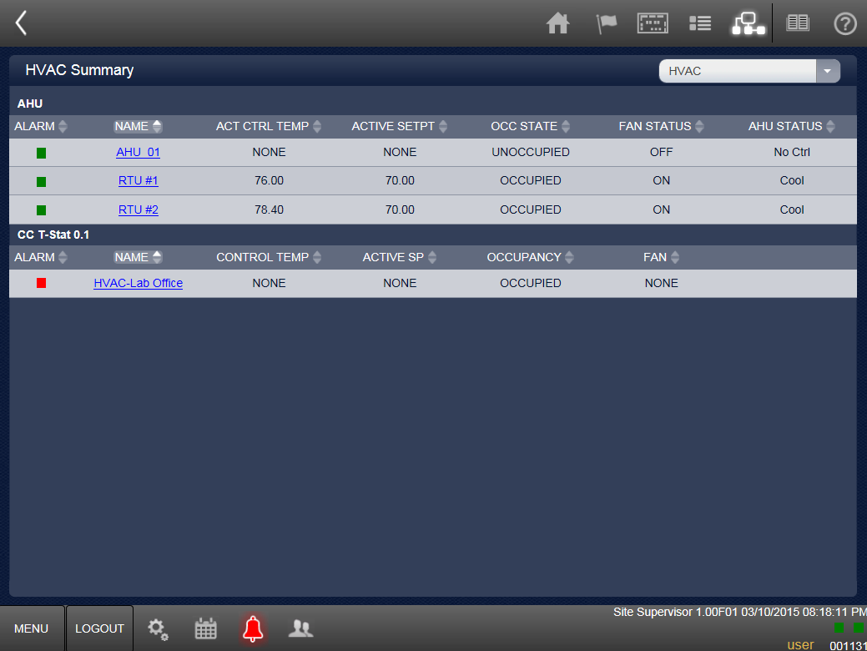
View Store Status
Notes:
So, for example, if we choose HVAC Summary, we are taken to this screen, which lists all HVAC applications. Again, you can click on a specific application to dig deeper into status details.

Slide 42
ecoSYS Site Supervisor View/Change COM Ports
Notes:
At some point, you may need to add or remove devices to the Site Supervisor system, which might require you to change COM Port settings. In this module, we’ll review how to view and change COM port settings.
Intro
Wednesday, March 13, 2001
42

Slide 43
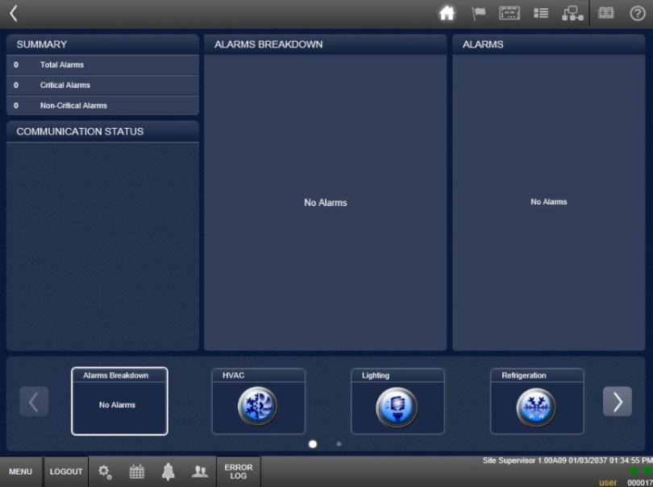
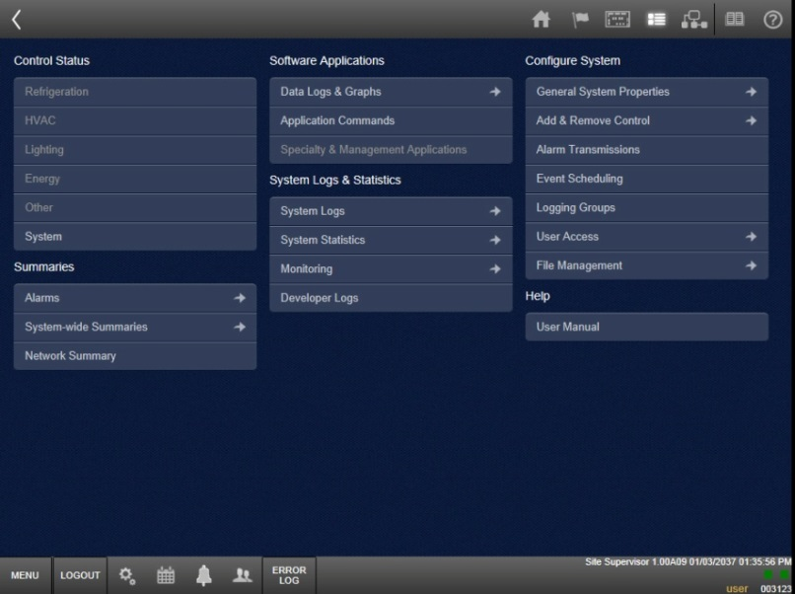
View/Change COM Ports
Go to Site Map
Choose General System Properties
Notes:
Begin by logging into Site Supervisor and going to the Site Map. From the site map, choose General System Properties.

Slide 44
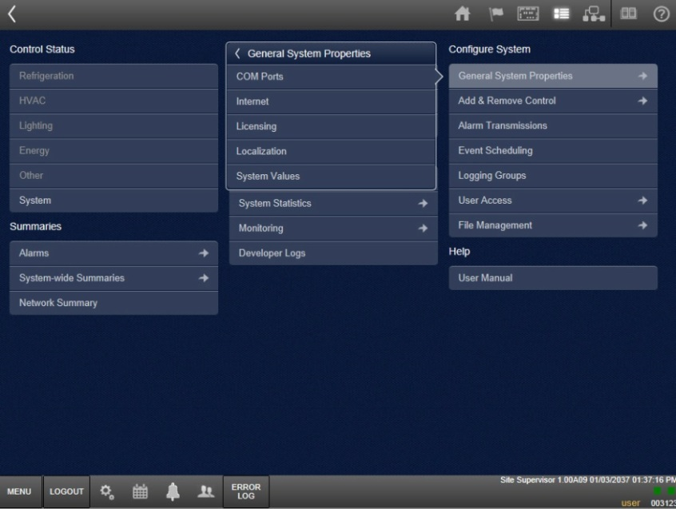
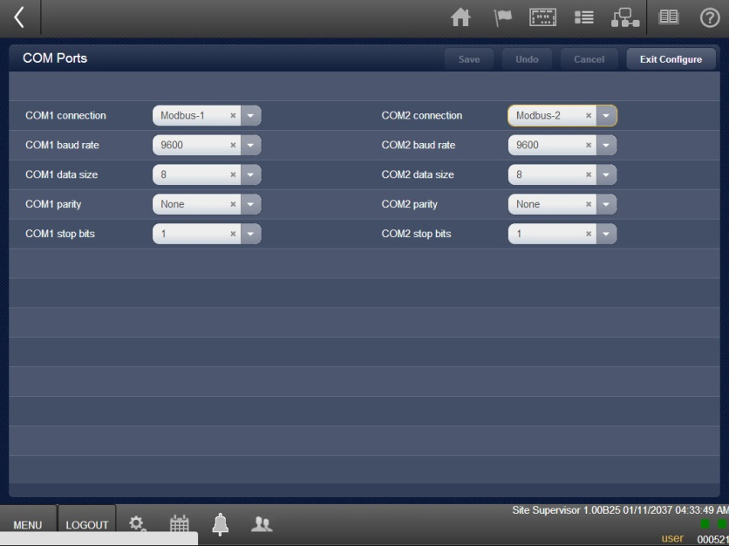
View/Change COM Ports
Choose COM Ports
Go to Configure
Use dropdowns to make changes
Click Save
Notes:
From the menu, choose COM PORTS, then select CONFIGURE.
On the configuration screen, make any desired changes using the dropdown fields, then click SAVE.

Slide 45
ecoSYS Site Supervisor View/Change Internet Values
Notes:
If any changes have been made to your network system, you may need to modify settings in Site Supervisor. These changes could include changes to your IP, your server settings, or your email configuration. In this section, we’ll review how to view and change Site Supervisor Internet values.
Intro
Wednesday, March 13, 2001
45

Slide 46
View/Change Internet Values
Go to Site Map
Choose General System Properties
Notes:
Log in to Site Supervisor and go to the Site Map, then choose GENERAL SYSTEM PROPERTIES.

Slide 47
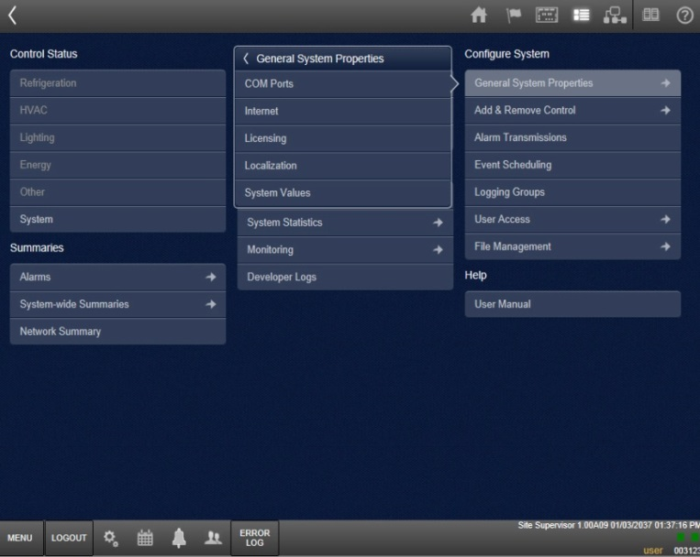
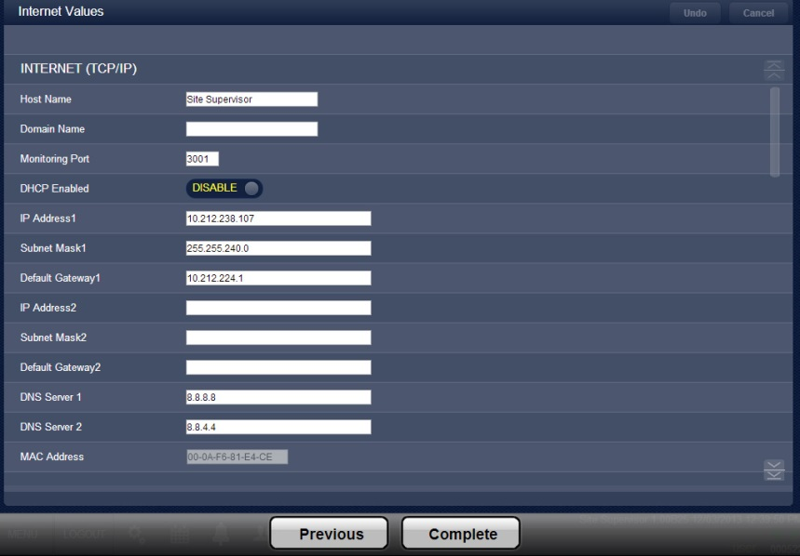
View/Change Internet Values
Select Internet
Choose Configure
Can make changes to IP, server, email, and text settings
Select Complete when finished
Notes:
From the menu, select INTERNET, then choose CONFIGURE.
You will recognize this as the same internet setup screen from the setup wizard. You can make changes to the IP, server, email, and text settings.
After making changes, select COMPLETE.

Slide 48
ecoSYS Site Supervisor View/Change Licensing
Notes:
You may need to expand the controller’s capabilities. This can be done by adding a license that allows you to expand a variety of control applications such as the number of lighting circuits, schedules, or rooftop units. To secure additional licenses, contact customer support at 770.425.2724. This training module covers how to view and change Licensing.
Intro
Wednesday, March 13, 2001
48

Slide 49
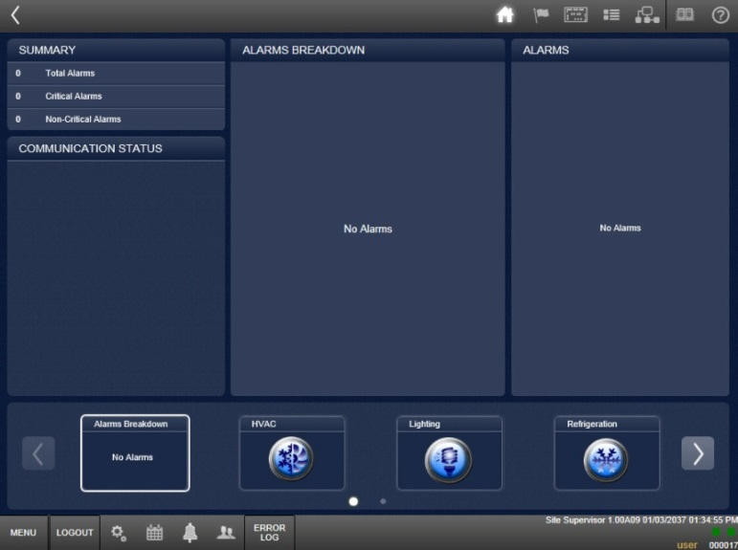
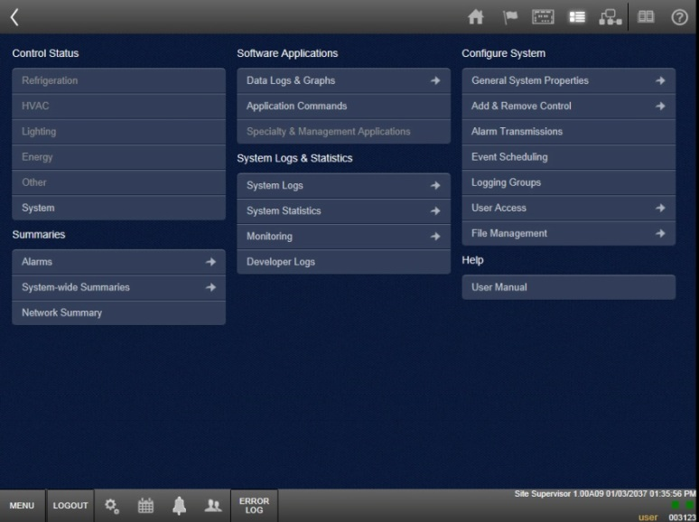
View/Change Licensing
Go to Site Map
Choose General System Properties
Notes:
First, log in to Site Supervisor and go to the Site Map. Choose GENERAL SYSTEM PROPERTIES.

Slide 50
View/Change Licensing
Choose Licensing
Select Configure
To add devices or quantities, click Add; entry box will appear
Notes:
From the menu, select LICENSING. Then choose CONFIGURE.
Here you will find the number of devices available.
To add devices or quantities, click ADD. A license number entry box will appear. Make any needed changes and save.

Slide 51
ecoSYS Site Supervisor View/Change Localization
Notes:
It is unlikely that you will need to change Localization settings, but if you do install Site Supervisor in a different location or for any reason need to make changes to preferred engineering units or to the date and time format, you will need to make adjustments in the Localization settings. In this training module we will learn how to view and change Site Supervisor Localization settings.
Intro
Wednesday, March 13, 2001
51

Slide 52
View/Change Localization
Go to Site Map
Choose General System Properties
Notes:
Log into Site Supervisor and go to the Site Map. From there, choose GENERAL SYSTEM PROPERTIES.

Slide 53
View/Change Localization
Go to Localization
Select Configure
Can make changes to Localization settings
Notes:
From the menu, go to Localization. Next, select CONFIGURE.
You will recognize this as the same internet setup screen from the setup wizard. Here you can make changes to the Localization settings.

Slide 54
ecoSYS Site Supervisor View/Change System Values
Notes:
In the event that you need or want to make a change to the system name, phone number, time zone, e-mail address, or port settings, you’ll need to do that by changing system values. This training module covers viewing and changing System Values.
Intro
Wednesday, March 13, 2001
54

Slide 55
View/Change System Values
Go to Site Map
Choose General System Properties
Notes:
First, log in to Site Supervisor, then go to the Site Map.
From the menu, choose GENERAL SYSTEM PROPERTIES.

Slide 56
View/Change System Values
Choose System Values
Select Configure
Make changes to System Values settings
Notes:
From the General System Properties menu, choose SYSTEM VALUES.
Next, select CONGURE.
The screen that appears is the same internet setup screen from the setup wizard. Here you can make changes to the System Values settings.

Slide 57
Questions?
Notes:
Intro
Wednesday, March 13, 2001
57

